Slide 1


Como estão funcionando hoje (2020):
1 - Utilities;
2 - Wholesale Market (Day-ahead, Real-time market; Ancillary Service Market; Capacity Market);
3 - Competitive Retail;
4 - Transactive Energy (DERs – Distributed Energy Resources).

Slide 2
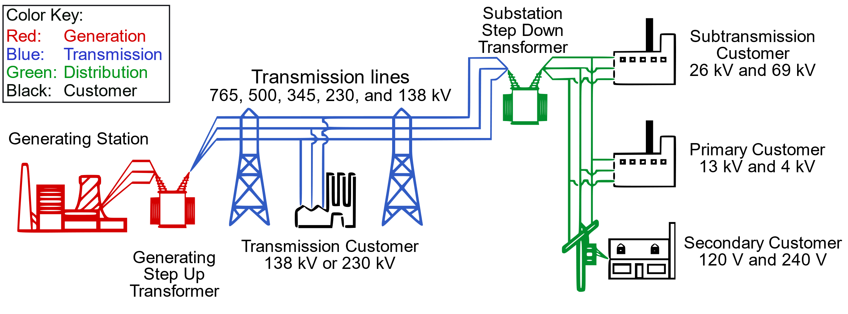
Fonte: wikipedia
Wholesale Market:
Grande Geração (algumas GENCO´s terceirizam o “Billing”)
Grandes Consumidores (estão usando painéis fotovoltaicos e tornando-se “prosumers”; às vezes terceirizam a Gestão do Negócio da Eletricidade)
VPP - Virtual Power Plants (Ancillary Services, etc.)
As velhas Utilities (cuidam do fio da trans., subtrans. e distri. e compram energia para seus consumidores)
As Comercializadoras (o SAP das COMERC´s)
Trade de Energia nas Bolsas e também Derivativos
Retail Market (pode ser Competitivo ou não):
Consumidores Médios e Pequenos Consumidores Residenciais e Comerciais (estão usando painéis fotovoltaicos+EV+Storage e tornando-se “prosumers” usando a regulação do “net metering”. Na maioria das vezes terceirizam a Gestão)
Regulated Retail Tariff
Competitive Retailer
VPP - Virtual Power Plants (Ancillary Services, etc.)
O Competitive Retailer vai fazer a Gestão do Pequeno e Médio consumidor ou o consumidor vai querer contratar um terceiro?

Slide 3
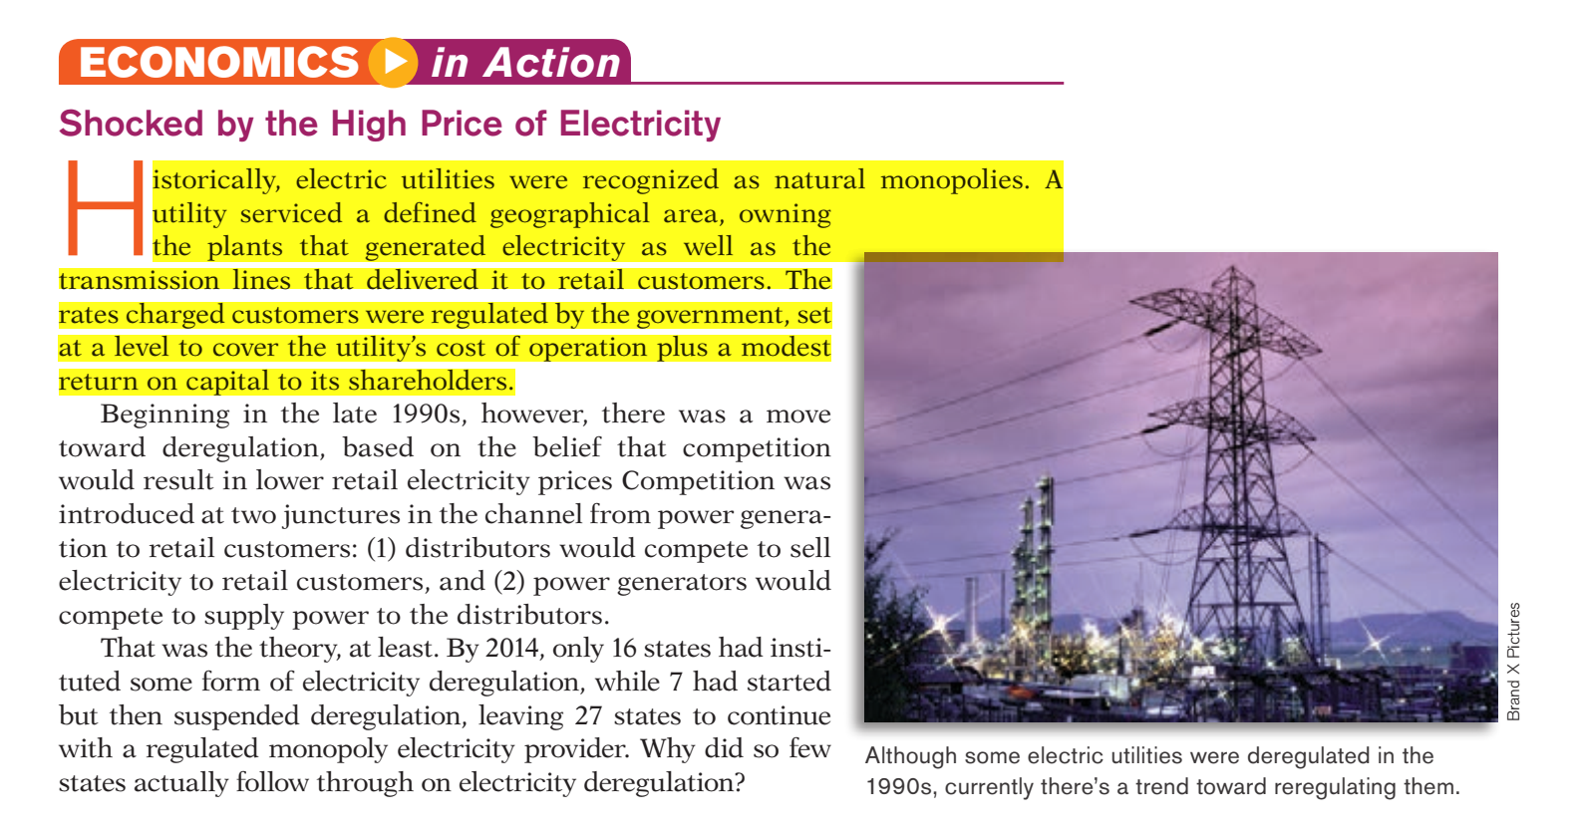
A melhor definição
de “Utility”
Paul Krugman and Robin Wells, “Economics”, 4th Ed., 2015

Slide 4
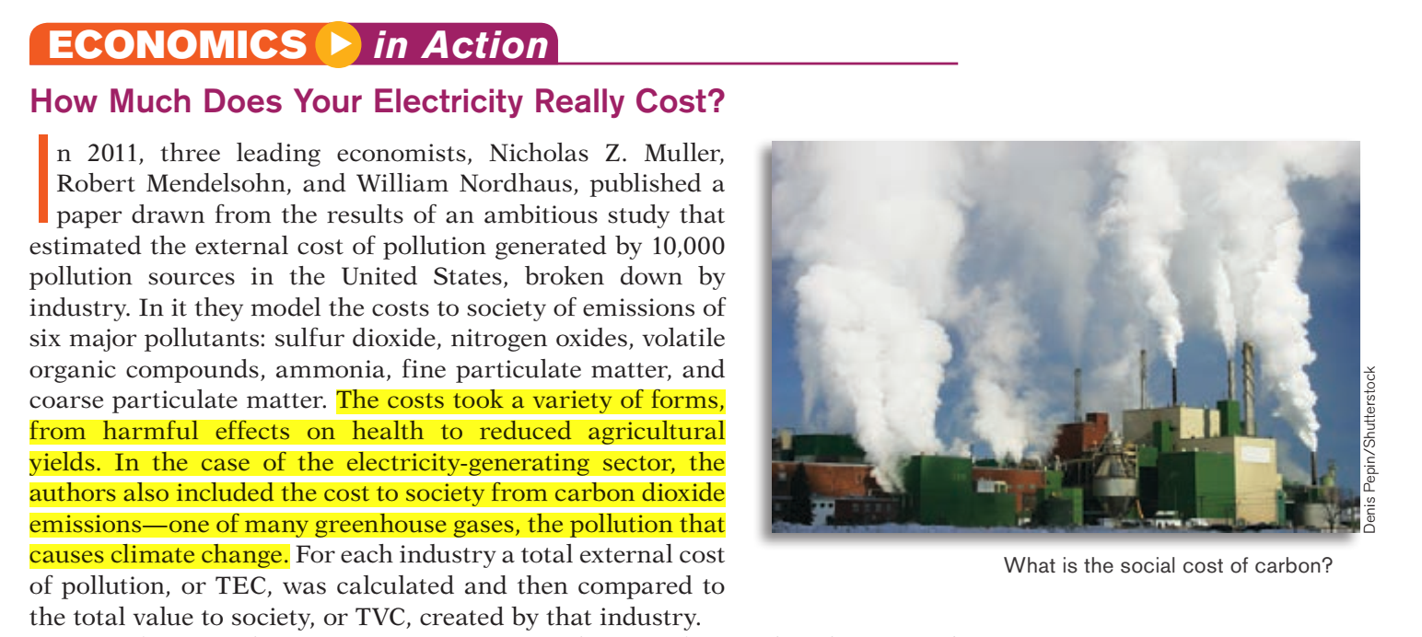
Paul Krugman and Robin Wells, “Economics”, 4th Ed., 2015

Slide 5

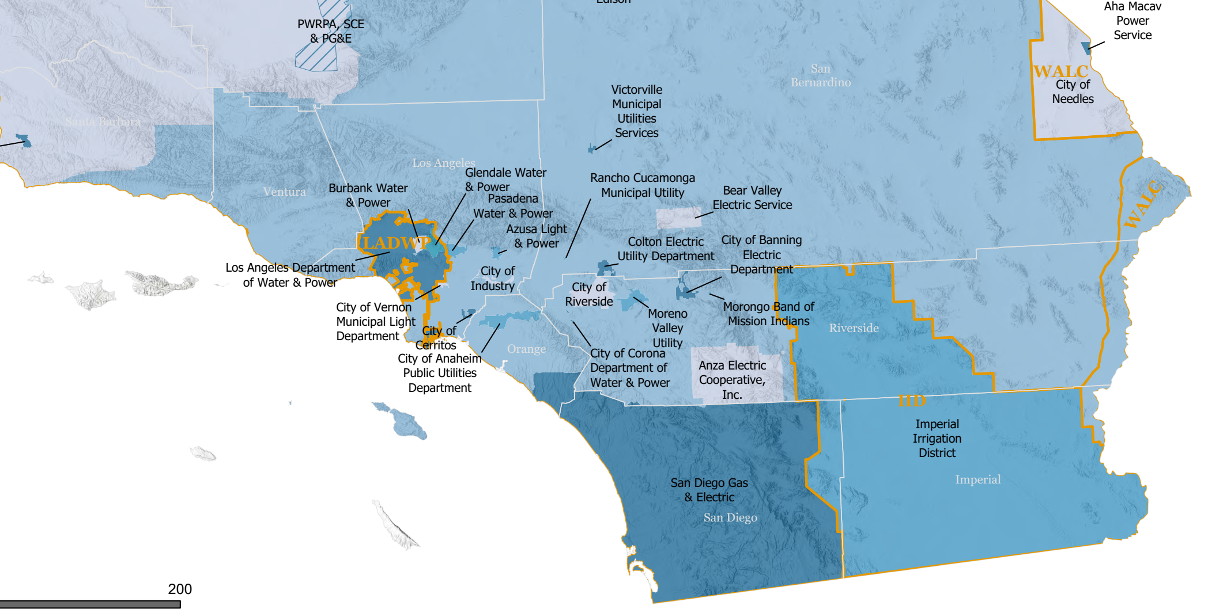
Mostrando o sul da California só para
Exemplificar as várias Utilities

Slide 6
3 - Competitive Retail;

Slide 7
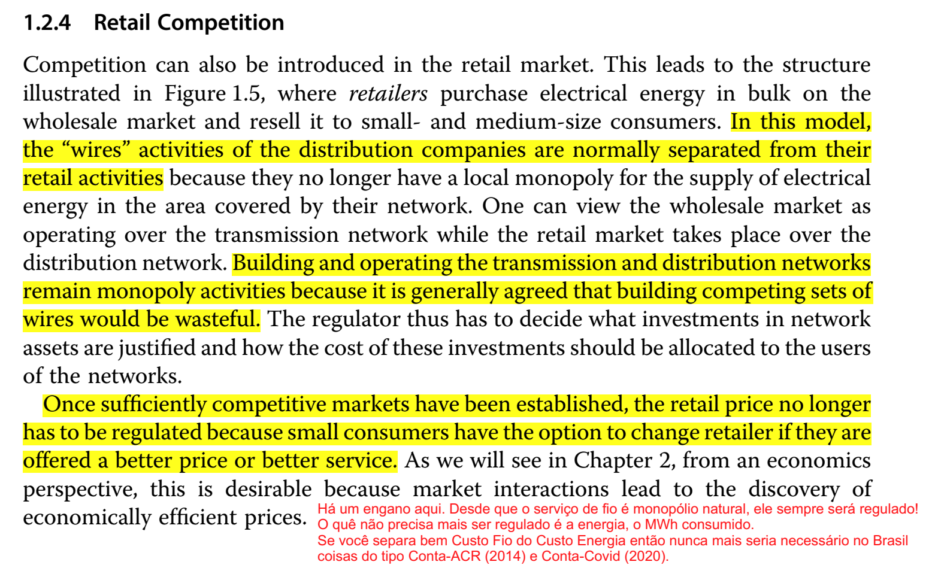
Daniel S. Kirschen and Goran Strbac, "Fundamentals of Power System Economics", 2nd Edition, Wiley, 2019.

Slide 8
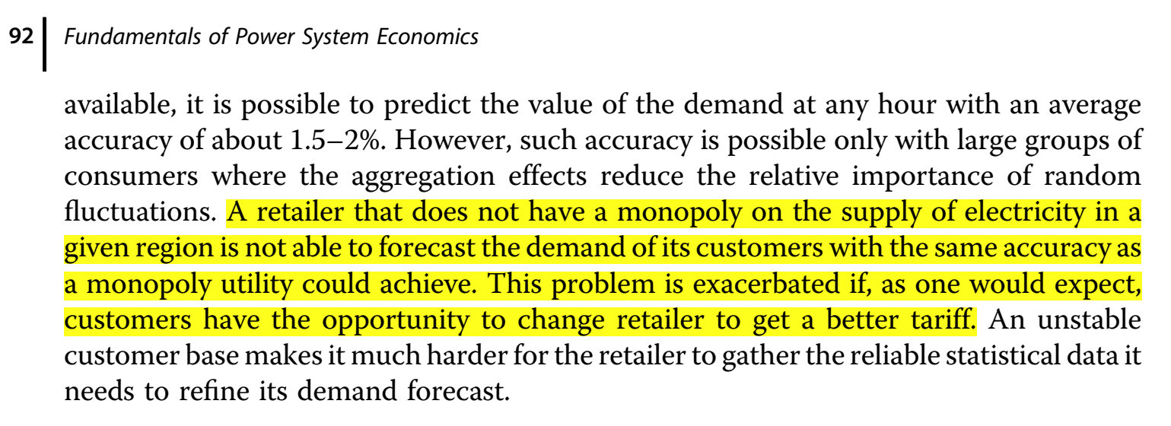
Competitive Retailer
Daniel S. Kirschen and Goran Strbac, "Fundamentals of Power System Economics", 2nd Edition, Wiley, 2019.

Slide 9
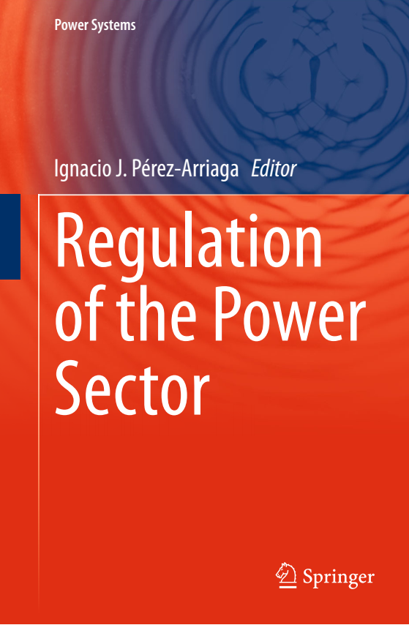
Chapter 9
Electricity Retailing
Carlos Batlle
9.1 Introduction
9.1.1 Unbundling of the Electricity Tariff for Consumers
9.1.2 Objectives of Retail Business Liberalisation
9.1.3 Global Description of Retail Activities
9.2 End-User Price Regulation: Retail Market Development and Regulated Tariffs
9.2.1 Degree of Deregulation of the Retail Business Worldwide
9.2.1.1 European Union
9.2.1.2 The Slow-Pace or the Stagnant Development of American Retail Markets
9.2.2 Regulated Energy Tariffs: First or Last Resort
9.2.2.1 Scope of Regulator Protection
9.2.2.2 The Real ‘‘Last Resort’’: The Back-Up Supplier
9.2.2.3 Default Supplier
9.2.2.4 Vulnerable Customers and Energy Poverty
9.2.3 What Should be Done with the Default Tariff for Small Consumers?
9.2.3.1 The Pass-Through Alternative
9.2.3.2 The Defence of the Retail Market Option
9.2.3.3 One Step Further in the Pass-Through Alternative
9.2.3.4 The Final Defence: Giving the Market Option an Initial Boost
Ignacio J. Pérez-Arriaga (Editor), “Regulation of the Power Sector”, Springer, 2014.

Slide 10
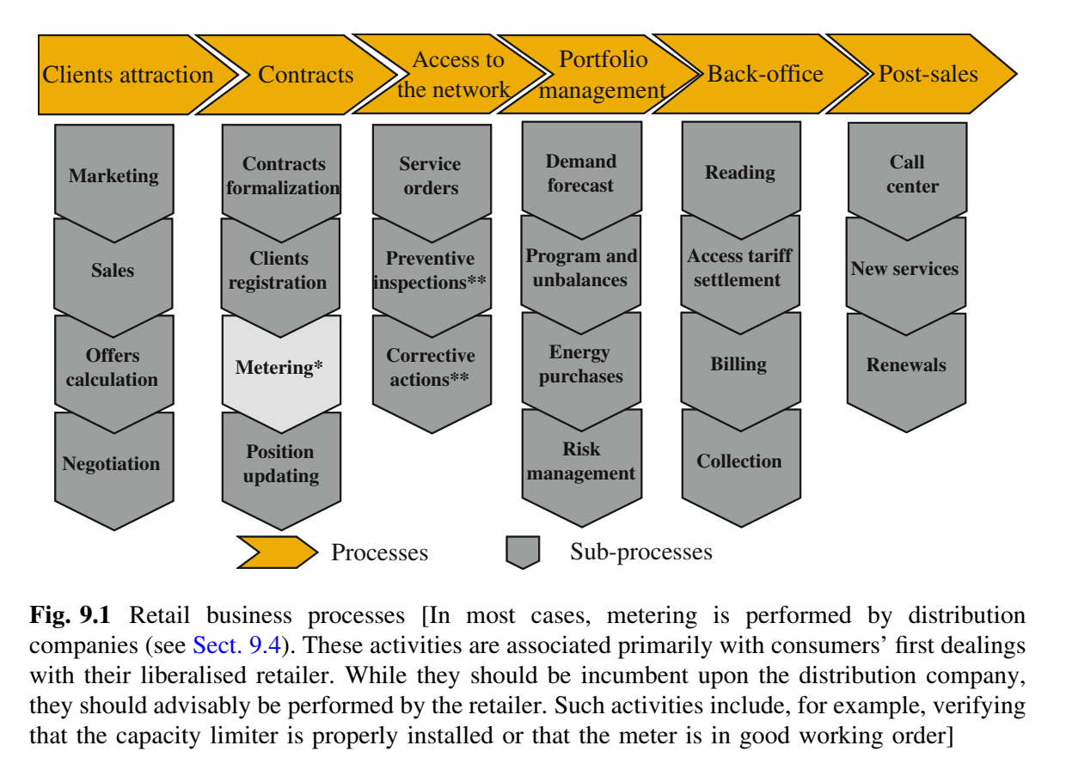
Veja que o autor separa bem
o subprocesso de “METERING”,
do subprocesso de “BILLING”.
Ignacio J. Pérez-Arriaga (Editor), “Regulation of the Power Sector”, Springer, 2014.

Slide 11
9.2.1 Degree of Deregulation of the Retail Business Worldwide
9.2.1.1 European Union
The European Directive 2009/72/EC states, with regard to retail competition: ‘‘the interests of the Community include, inter alia, competition with regard to eligible customers’’. It goes on to say that ‘‘Member States shall ensure that eligible customers comprise: (…) from 1 July 2007, all customers’’. Full eligibility is therefore mandatory in the European Internal Electricity Market.
Nonetheless, the degree of retail market liberalisation and competition varies significantly across the Union. In practice, not many Member State governments are overjoyed at the thought of losing their ability to control energy prices. The French Government, for instance,
While the European Directive establishes the EU’s commitment to full eligibility, it also states that an ‘‘affordable’’ energy supply service should be guaranteed: ‘‘Member States shall ensure that all household customers, and (…) small enterprises, (…), enjoy universal service, that is, the right to be supplied with electricity of a specified quality within their territory at reasonable, easily and clearly comparable and transparent prices’’. It further declares: ‘‘To ensure the provision of universal service, Member States may appoint a supplier of last resort’’. While it opens the door to such suppliers, it does not specify their required characteristics, or much less what criteria must be met by the rates that they offer or which consumers should be entitled to it.
As discussed below, this wording has been interpreted by some Member States to mean that they still can decide whether energy market prices at any point in time are reasonable or not. In many other Member States, regulated last-resort tariffs (in their default format; see discussion below) protect a significant share of consumers. A number of governments still retain the prerogative to set price caps or any other manner of rules to avoid passing market prices on to some or all end-users.
Ignacio J. Pérez-Arriaga (Editor), “Regulation of the Power Sector”, Springer, 2014.

Slide 12
9.4 Metering
9.4.1 Liberalisation of the Metering Activity
Metering has been traditionally considered to be a part of network operation. Electro-mechanical metering equipment was regarded as the obvious technology for small consumers and, since no improvement was foreseen, metering was regulated as a monopoly business. However, power system restructuring, allowing explicit nearly real-time prices for consumers (each hour or each quarter of an hour), and technological developments have opened the door to competition.
Two of the very few (at this writing) examples of power systems where metering has been liberalised are the UK and Germany. In the latter country metering was deregulated in 2008, the distribution company remains as the ‘‘default’’ metering operator, subject to a regulated tariff, and consumers can choose their operator and, in particular, the type of meter desired. In the UK, price controls have been restricted to the equipment installed by distribution network operators prior to 2007 [40].
In Germany metering was deregulated in 2008, the distribution company remains as the ‘‘default’’ metering operator, subject to a regulated tariff, and consumers can choose their operator and, in particular, the type of meter desired.
Ignacio J. Pérez-Arriaga (Editor), “Regulation of the Power Sector”, Springer, 2014.

Slide 13
Ou seja, você pode contratar o “Metering” com uma empresa e a Energia (“Billing”) com outra?
Ou o teu Competitive Retailer oferecer vários “pacotes” de “Metering”?

Slide 14
Annex A - Retail Processes
A.1.1 Sales
A.1.2 Front-Office Area
A.1.3 Middle-Office Area
Types of contracts
Since the most significant of all the above risks is indisputably the price risk, much of a supplier’s business involves optimising its energy purchases and the agreements concluded with both the generators from which it buys energy on the wholesale market and the customers to whom it sells electric power, to protect itself against price risk.
From a consumer’s viewpoint, one of the key services offered by a supplier is the possibility of hedging against price risk.
Many consumers simply cannot buy their electricity directly on the wholesale market because they cannot afford to run the risk inherent in market price fluctuations. To avoid such risks, they will try to negotiate a product with their supplier that allows them to reasonably forecast their energy costs.
Although there is a wide variety of commercial formulas in place, the most widespread (and simplest) models are as follows:
Ignacio J. Pérez-Arriaga (Editor), “Regulation of the Power Sector”, Springer, 2014.

Slide 15
Although there is a wide variety of commercial formulas in place, the most widespread (and simplest) models are as follows:
1. - Flat rate: This type of contract stipulates a flat rate per kWh used by customers. In this case, the supplier absorbs the full risk associated with uncertainty in the pool price. This system is particularly suited to small-scale agents or for large customers with a very constant level of consumption, which they are essentially unable to change, who want to avoid highly complex rate schemes. This is very common among smaller customers.
2. - Time-of-day: These contracts group the hours of the day into several different segments, each of which has a different price per kWh. Customers able to change their load profile in line with prices find this kind of contract attractive because they can benefit from its flexibility. In this case, the supplier shoulders price risk, but not quantity risk. The hours of the day must be grouped into segments, each comprising a time frame during which wholesale prices are likely to be similar.
3. - Pass-through: In this case, the supplier merely charges the customer the wholesale market price for each hour, multiplied by the amount consumed during that hour, plus the access charges stipulated by the regulator. In this case the customer shoulders all the risks, while the supplier merely offers an intermediary service (it represents the consumer on the spot market, deals with billing, handles relations with the distributor and so on). This type of contract may suit very large customers who are well acquainted with how the electricity market works and prefer to handle their energy purchases themselves.
4. - Contract for differences: This is a standard contract for differences between the end consumer and the retailer, for a predetermined load profile and a strike price, which uses the hourly spot market price as the reference price in the contract. Therefore, if the consumer strictly follows the contracted demand pattern, she is completely hedged and she pays the strike price for the demand. However, any deviations from the contracted load profile will be charged or credited at the current value of the spot market price. This type of contract has the double desirable property of hedging for the totality of the forecast consumer demand and sending the correct real time economic signal to the consumer.
Ignacio J. Pérez-Arriaga (Editor), “Regulation of the Power Sector”, Springer, 2014.

Slide 16
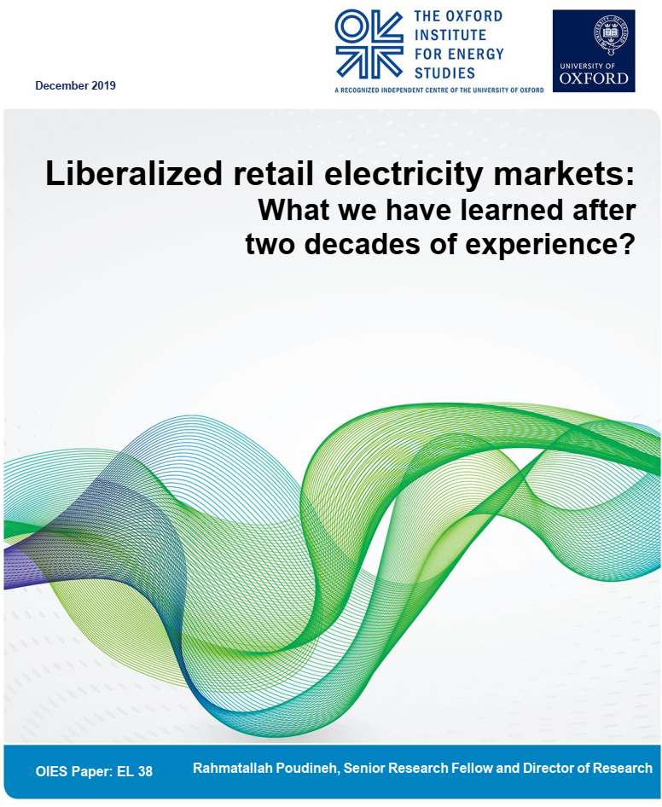
An entry barrier in a retail electricity market is often related to the following four factors:
(i) economy of scale; (ii) economy of scope; (iii) sunk costs; and (iv) social and environmental obligations and regulatory requirements.
A supplier who wishes to enter the retail business might need to serve a certain number of customers before its business becomes profitable (economy of scale). The cost of acquiring customers is often high for new retailers, especially if there exists a huge portion of disengaged customers who are not visible to new entrants.
The second issue is related to the scope of competition in retail markets. Although the main activity of a retailer is to procure energy and manage the risk on behalf of its customers, there are sometimes other activities that are subject to retail competition such as metering, billing, credit assessment, bill collection, and outage reporting. A retail market with a wide extent of competitive activities would create economies of scope for established large suppliers, while it creates a barrier to entry for new and small retailers who are not able to provide all those services (economy of scope).
The third problem is that entering a retail business entails investment in software, algorithm and computation capabilities, website and call centres to deal with the complexity of participation in the wholesale market, risk management, bill collection, and consumer relationship management. The capital requirement for these investments may thus act as a barrier to entry (sunk costs).
R. Poudineh, “Liberalized retail electricity markets: What we have learned after two decades of experience?”, Oxford Institute for Energy Studies, 2019.

Slide 17
R. Poudineh, “Liberalized retail electricity markets: What we have learned after two decades of experience?”, Oxford Institute for Energy Studies, 2019.
In order to promote competition, regulators need to design appropriate policies to deal with the entry barrier issues mentioned above. In different jurisdictions, various measures have been proposed and implemented. For example in the UK, to reduce the costs of acquiring customers to new suppliers and to help disengaged customers, the Competition and Markets Authority (CMA) has asked the regulator, Ofgem (the Office of Gas and Electricity Markets), to develop and operate a secure database which contains information (energy usage and tariff plan) on customers who have been on a default tariff with the same supplier for at least three years (Ofgem, 2019a). This database would then be available to existing suppliers as well as to new entrants.
Ofgem (the Office of Gas and Electricity Markets), to develop and operate a secure database which contains information (energy usage and tariff plan) on customers
In order to reduce barriers related to economy of scope, in many US states network companies are required to offer retailers a consolidated billing service with the option to purchase the receivables of retailers (Ros et al., 2018). However, this has been subject to criticism because although a reduction in the scope of retail services might lower entry barriers, it can also reduce the incentive of retailers to innovate…. Similarly, to help small suppliers enter the market and compete with incumbents, in the UK, retailers with fewer than 250,000 customers are exempted from Energy Company Obligations (ECO) and the Warm Home Discount (WHD) (Ofgem, 2018a). ECO is a governmental energy efficiency scheme which has the aim of reducing carbon emissions and tackling fuel poverty; its most recent project only focuses on Home Heating Cost Reduction Obligation (HHCRO). WHD is a scheme that offers low-income consumers a one-off discount (£140) on their electricity bill during cold months.
Seriam as Utilities??? Ou melhor as “Transmission and Distribution Providers?
in many US states network companies are required to offer retailers a consolidated billing service with the option to purchase the receivables of retailers

Slide 18
Experience of the retail electricity market in GB, as a pioneering liberalized jurisdiction, provides some interesting insights on market entry and competition... …at the beginning of this century (2004) there were a little over 10 active suppliers of gas and electricity, this number reached over 70 by September 2018 (the number of suppliers who provide either electricity or gas only is, however, very low, which means that dual fuel supply is more attractive to retailers than single fuel supply). A wide range of businesses entered the UK retail market; this included small and medium-sized suppliers, European utilities, international oil companies, and chain supermarkets (KPMG, 2018). It is expected that such diversity will result in innovations in terms of new and differentiated business models.
The downside of the market’s growth is that too many suppliers have come into the market with unsustainable business models. Since November 2016, 16 suppliers in the UK have failed and four have exited the market; a total of 20 suppliers have thus entered into ‘supplier of last resort’ arrangements (SoLR) (Energyscanner, 2019). A combination of issues such as low capital requirement, lack of industry experience, inability to manage risks, high wholesale costs, and the retail price cap have resulted in the insolvency of these companies.
R. Poudineh, “Liberalized retail electricity markets: What we have learned after two decades of experience?”, Oxford Institute for Energy Studies, 2019.

Slide 19
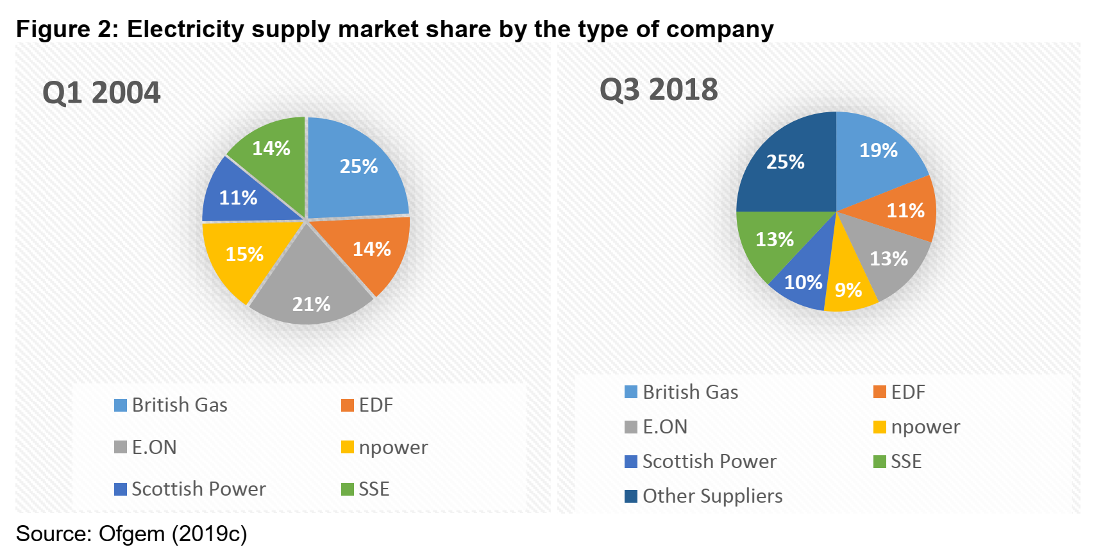
Apart from the possible correlation between rapid growth of retail market and failure of suppliers, the significance of the size of a supplier’s operation is also very important. Notwithstanding the high number of retailers, the GB retail electricity market is still concentrated. In 2004, the six major utility companies (British Gas, EDF, E.ON, npower, Scottish Power, and SSE – collectively known as the big six) had 100 per cent of retail market share. They still supply around 75 per cent of the market as of third quarter of 2018 (see Figure 2).
de 100% em 2004 para 75% em 2018
R. Poudineh, “Liberalized retail electricity markets: What we have learned after two decades of experience?”, Oxford Institute for Energy Studies, 2019.

Slide 20

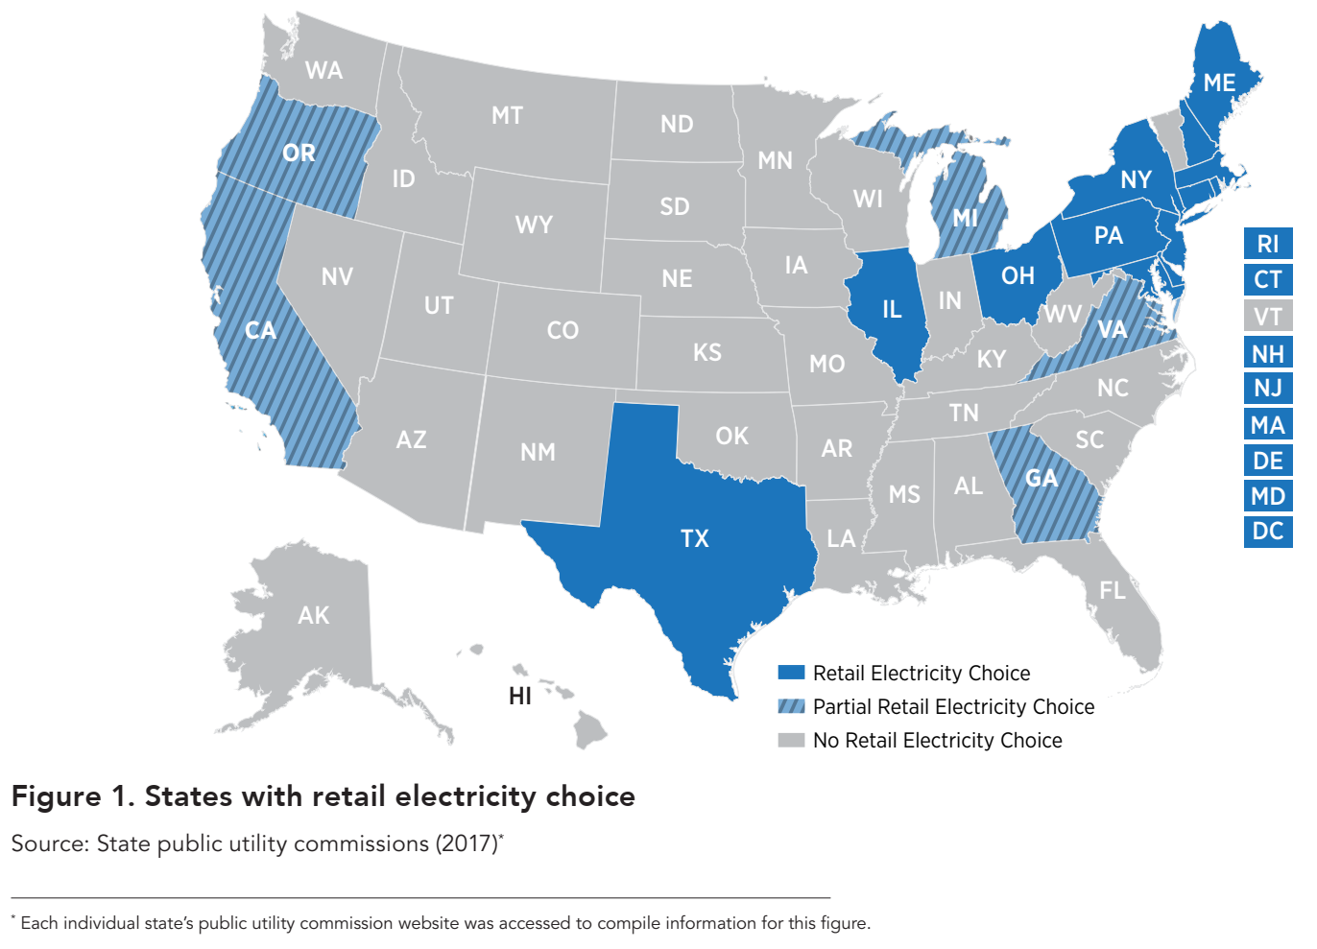
paper - NREL - Competitive Electricity Retail in United States - August 2017

Slide 21
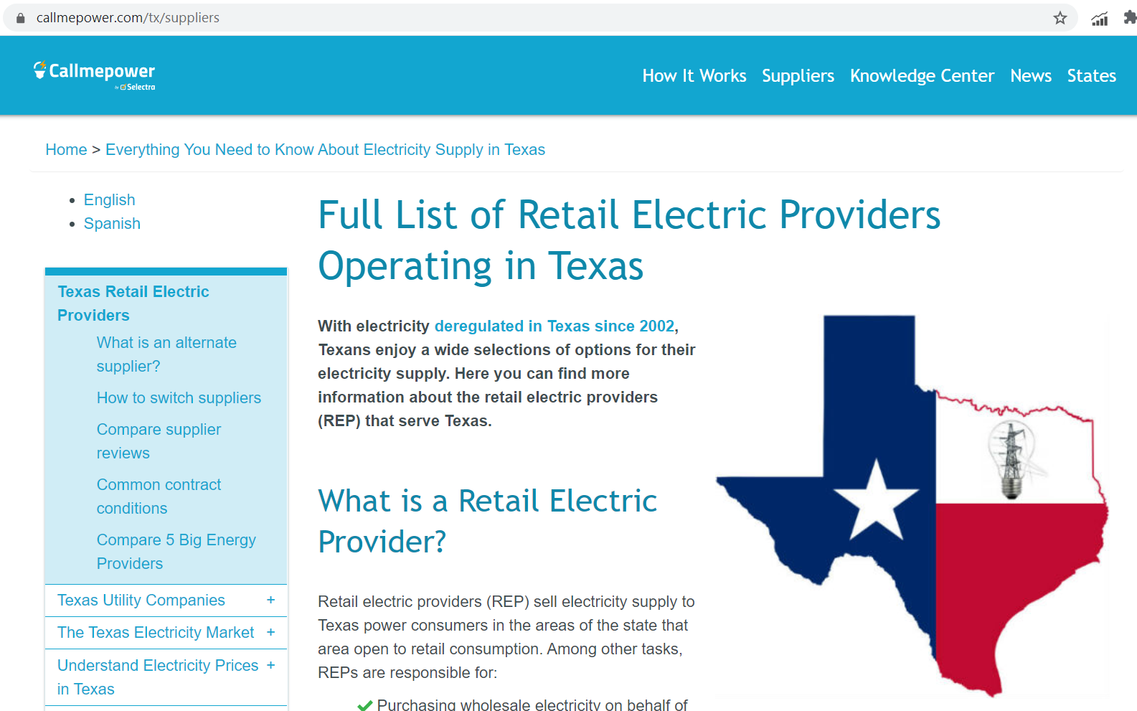

Slide 22
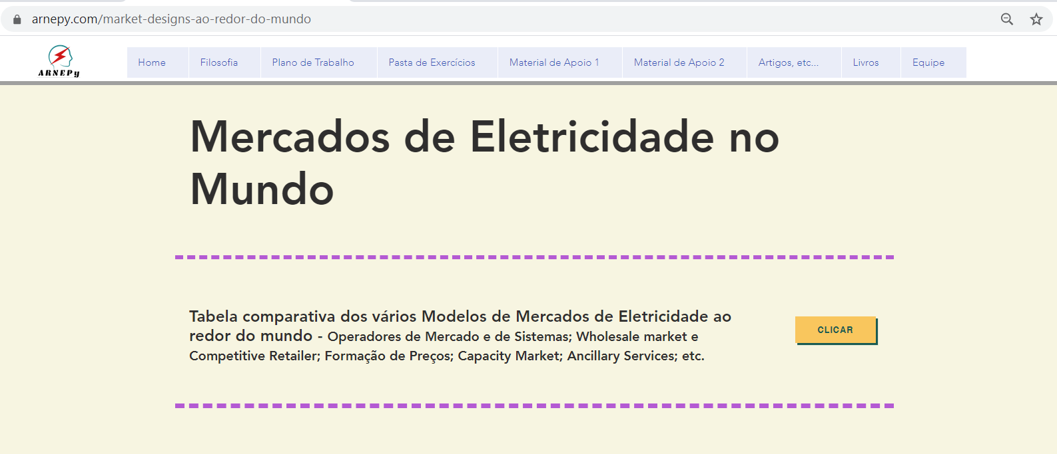

Slide 23
Questões sobre o
Competitive Retail

Slide 24
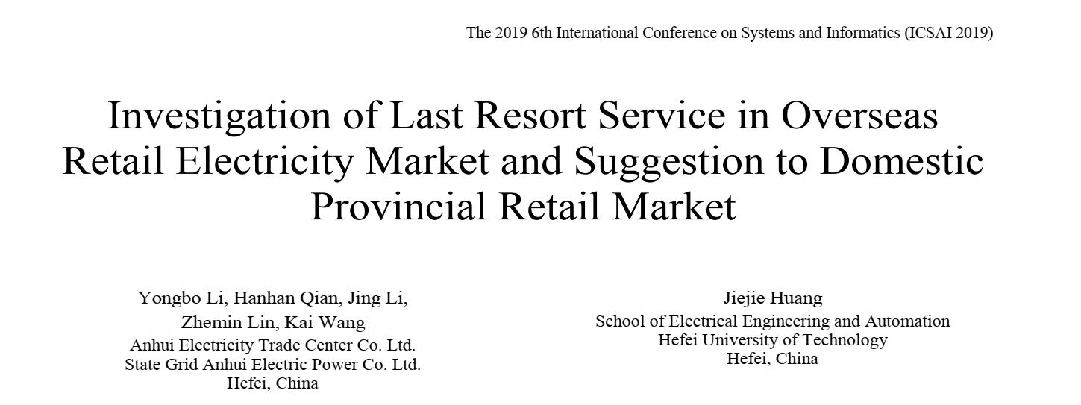
Comercialização Varejista – Frederico Rodrigues – 2018
24 de setembro de 2019 715 Visualizações
A discussão está, pois, em quem fica com o risco. Enquanto alguns sugerem que consumidor inadimplente seja compulsoriamente modelado em seu próprio nome na CCEE e o risco alocado ao mercado, outros refutam essa possibilidade, por considerar inadmissível que o mercado compartilhe do risco assumido voluntariamente pelo varejista e por inviabilizar a redução do crescimento da CCEE.
Há também sugestão de que o inadimplente seja modelado sob a distribuidora local, retornando compulsoriamente à condição de cativo.
Existe, ainda, proposta mais radical, ainda incipiente, que propõe transferir a responsabilidade de adesão, contabilização e liquidação dos consumidores livres para as distribuidoras, que seriam remuneradas para tanto, tornando desnecessária a figura do varejista.
Daí a sugestão de levar o assunto do varejista à ANEEL, para reabertura da discussão sobre sua regulamentação. Com o aceite da Agência para realização do workshop, pretende-se que entre outras, sejam abordadas as questões de como tratar os consumidores inadimplentes no mercado livre; as perdas comerciais; o convencimento do poder judiciário sobre o necessário corte do fornecimento de consumidores que não arcam com o seu consumo e a necessidade da existência de supridor de última instância.
https://abraceel.com.br/biblioteca/artigos/2019/09/comercializacao-varejista-frederico-rodrigues-2018/

Slide 25
Basicamente são:
1. - Last Resort Retailer (consumidores inadimplentes e também Retailers falidos);
2. - Open Utilities (o “metering” poderia ficar regulado e os dados à disposição do cliente); e
3. - Sustentabilidade e Pegada de Carbono.

Slide 26

TODAY, MOST AMERICAN RESIDENTIAL CUSTOMERS pay for electric service via tariffs that are structured as two-part rates consisting of a fixed monthly charge and a volumetric energy charge expressed in U.S. dollars per kilowatt-hour. The fixed-charge component generally comprises a small portion of the bill, which is dominated by the volumetric charge.
California’s energy crisis in 2001–2002 triggered an important discussion about the need to better connect retail and wholesale markets. Since then, scores of pilot programs have been carried out with time-varying rates. The empirical evidence shows that customers can understand and respond to incentives provided by new tariffs that convey the cost structure of electricity to customers. Additionally, smart meters now track the energy use of half of all U.S. residential customers, removing a major barrier to the deployment of modern tariffs.
Consequently, a misalignment between utilities’ cost and rate structures currently exists, particularly with respect to the residential class. In response to this challenge, many utilities are introducing innovative, cost reflective tariffs better aligned with both their own needs and those of their customers. In short, utilities seek to develop the tariffs of tomorrow.
Até nos USA a turma está discutindo a melhor forma de fazer as tarifas para as Utilities !!!
Mas na Europa eu não achei essa discussão.
Acho que é porque eles já tem o Competitive Retail há muito tempo !!!

Slide 27
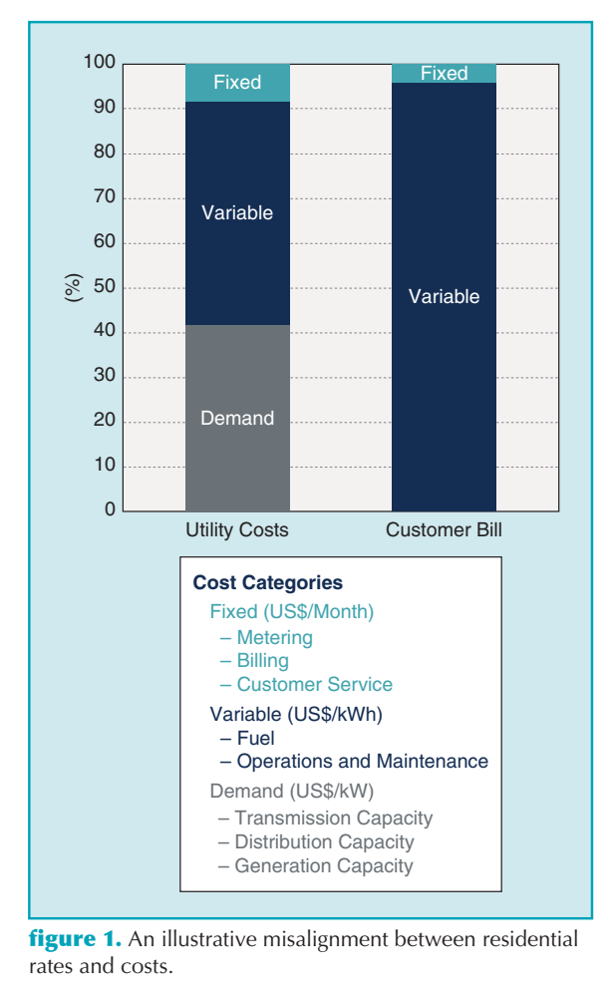
Veja que interessante: Lá nos custos de Demanda (US$/kW) aparece a “Generation Capacity”!!!
Lembrar o Capacity Market. E no Brasil podemos lembrar o CCEAR-Disponibilidade.
Aonde entra a energia que a Utility compra no Day-ahead Market (DAM) ???

Slide 28
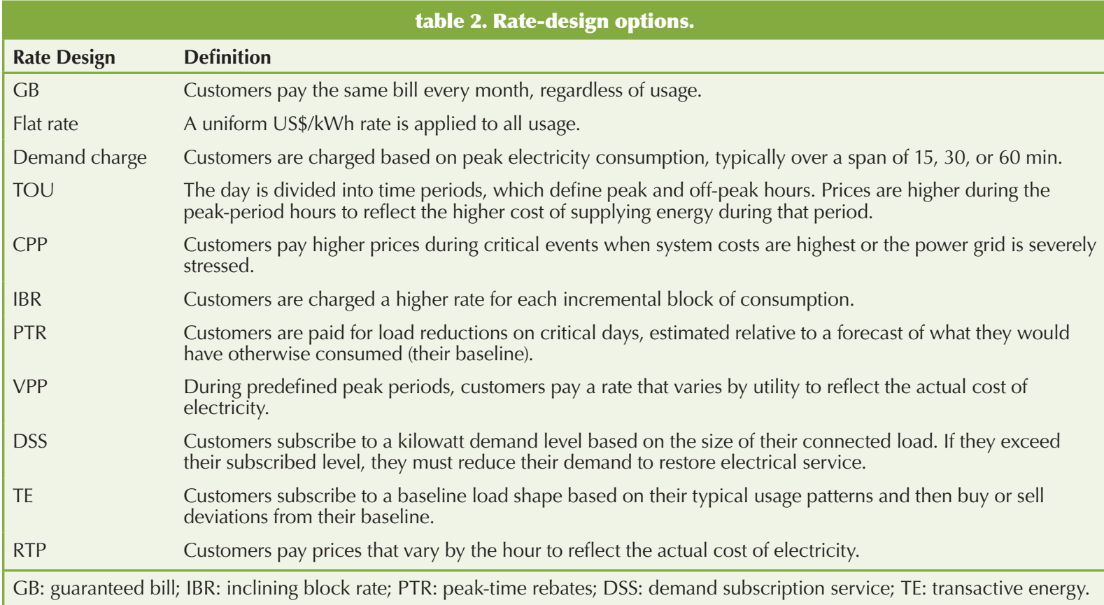
A California vai entrar no RTP em jan 2022
real-time pricing (RTP) rate.

Slide 29
Case Studies
Despite concerns about customer response, several utilities have already begun offering dynamic rate options with promising initial results. In Maryland, for example, the three largest utilities (Pepco, Delmarva Power, and Baltimore Gas and Electric) have each implemented peak-time rebates as the default tariff to all their customers. These programs have resulted not only in peak load reductions for the utility but also customer savings and satisfaction.
Figure 3 illustrates the results of 332 TOU, CPP, and PTR pricing experiments. Some of the 332 experiments had very high peak-to-off-peak ratios and could not be included in the figure. These results further support the idea of customer peak-load reductions in response to higher peak-to-off-peak price ratios. Some experiments provided a pure price signal to customers, whereas others included enabling technologies, such as smart thermostats, with the pricing signal. Around 14% of all U.S. utilities, including roughly half of all investor-owned utilities, now offer a residential TOU rate. Among these TOU rates, 6% now also include a demand charge on top of the time-varying volumetric charge. Although adoption rates for dynamic tariffs remain low, the successes of a few utilities show promise for customer willingness to adopt future tariffs.

Slide 30
Mostrando o sul da California só para
Exemplificar as várias Utilities

Slide 31
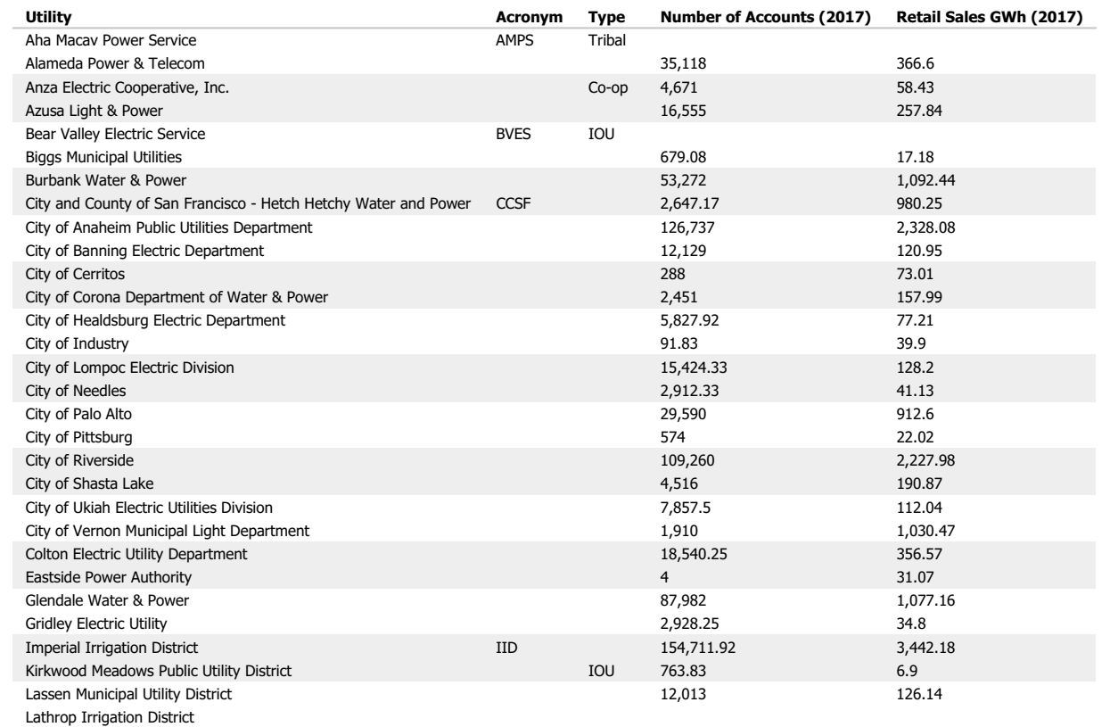

Slide 32
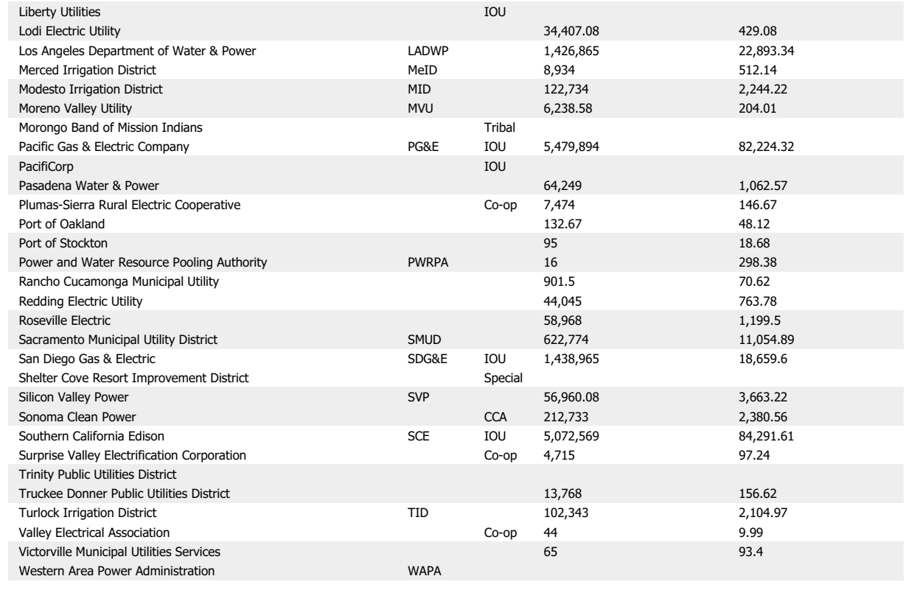
CCA – Community Choice Aggregation

Slide 33
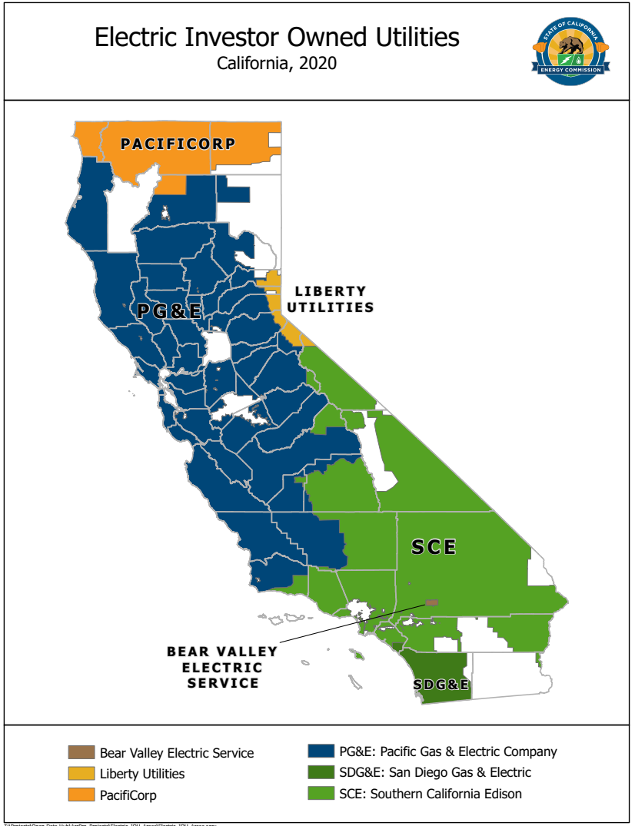

Slide 34
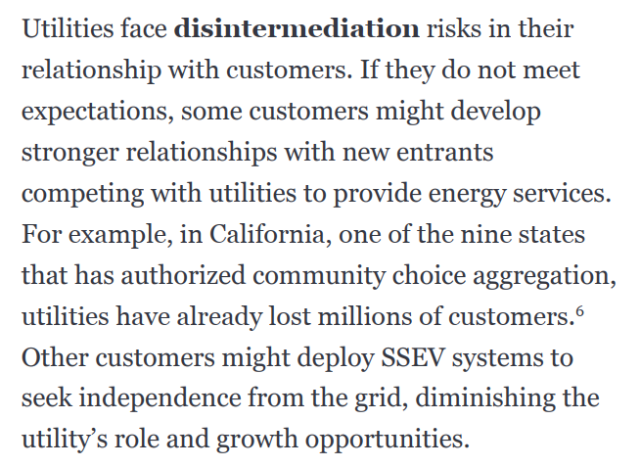
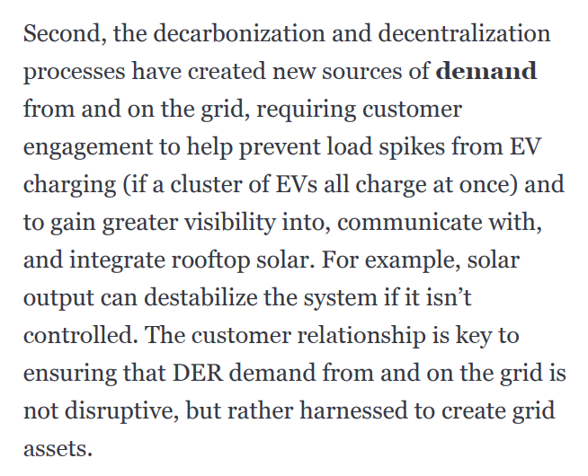
Community Choice Aggregation = California’s three big investor-owned utilities — Southern California Edison and Pacific Gas & Electric are the other two — are losing a growing number of customers to government-run power providers called community choice aggregators, or CCAs. There’s a good chance the monopoly utilities will lose the vast majority of their energy sales to CCAs and other energy providers over the next few years.
California had 19 community choice providers serving 2.6 million homes and businesses last year. Nearly 1 million homes in Los Angeles and Ventura counties are being enrolled this month in Clean Power Alliance, the state’s biggest CCA.
SSEV = Solar+Storage+Electric Vehicle
paper - Deloitte - Operating-an-energy-platform - fev 2020 - MUITO MUITO BOM.pdf

Slide 35
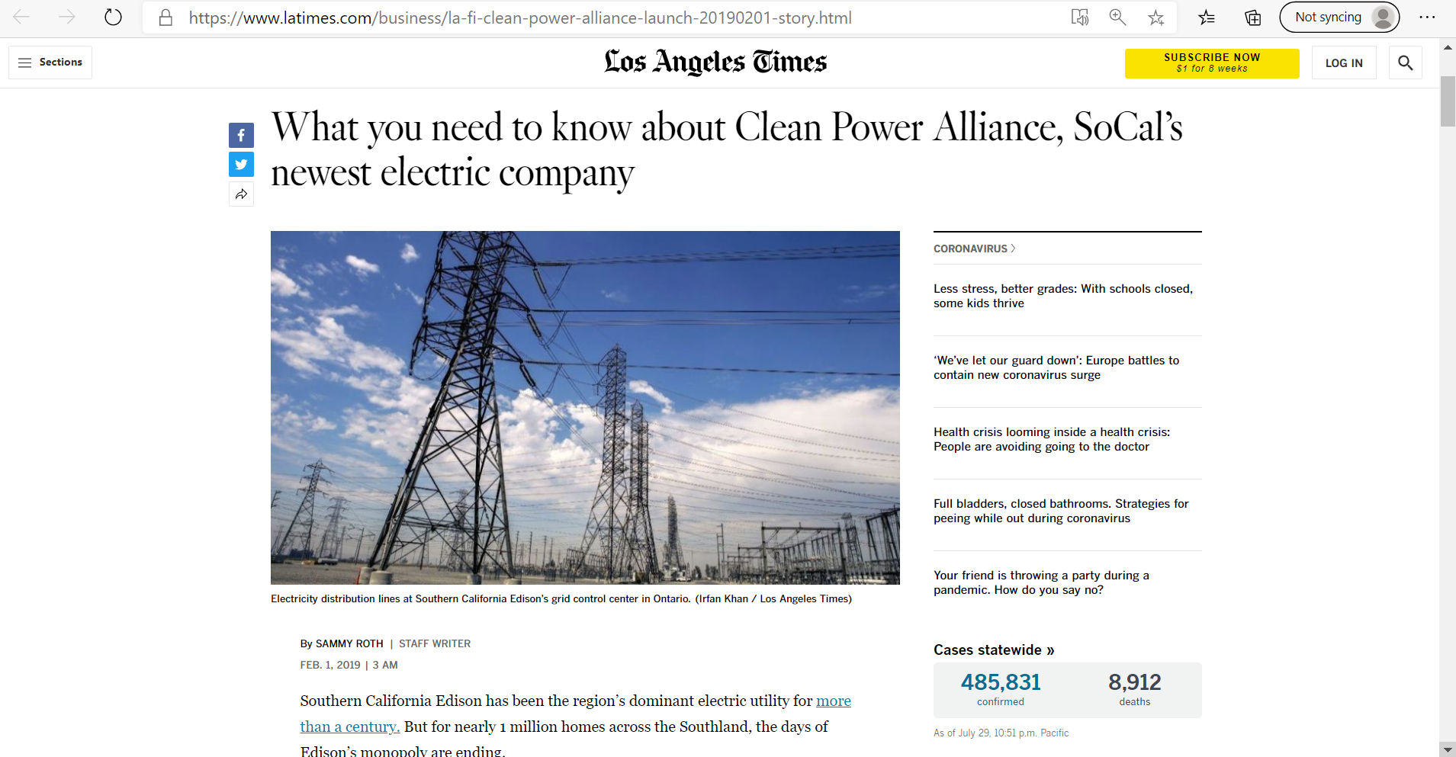

Slide 36
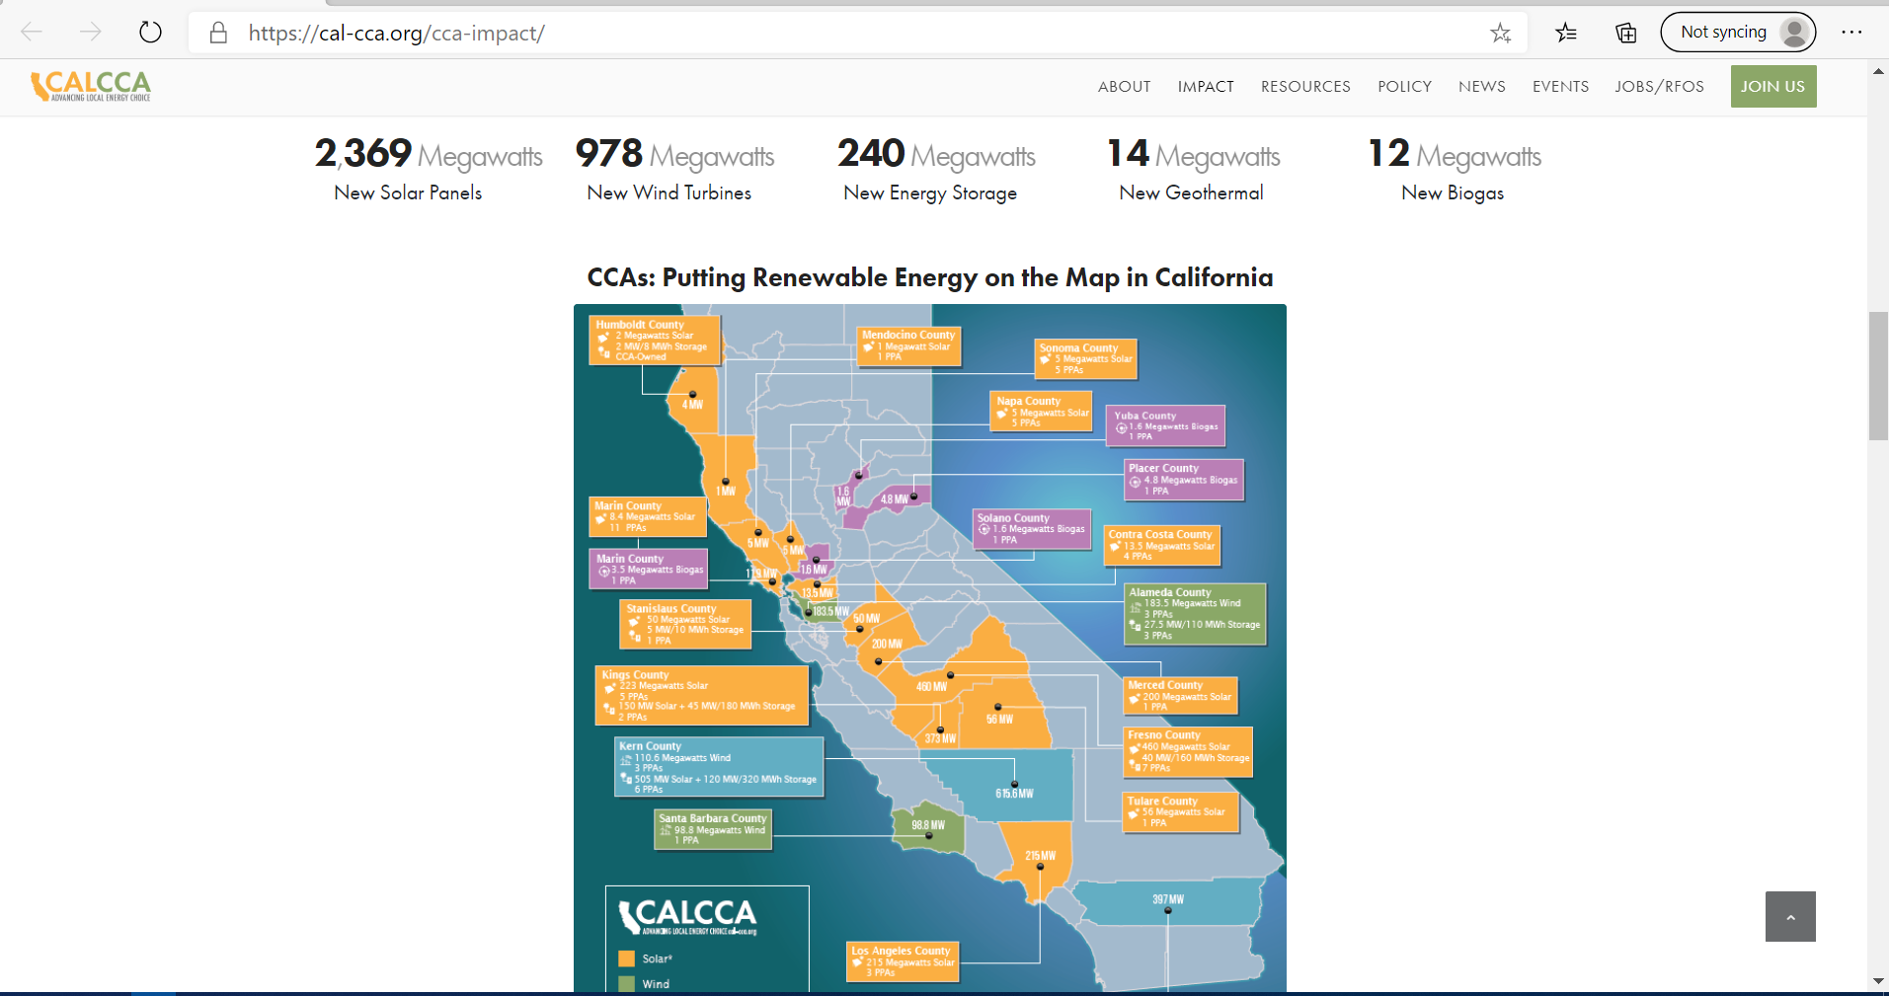

Slide 37
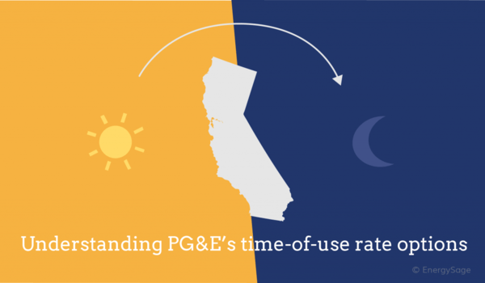
https://news.energysage.com/pge-rate-schedule-increase-solar/
The new PG&E rate schedule introduces an additional factor: time of use (TOU) rates.
Rather, TOU rates more accurately reflect how electricity prices vary throughout the day. When you pay a flat per-kWh rate regardless of the time of day, you probably don’t realize that your electricity costs more to generate and deliver when demand is high. TOU rates reflect these differences to encourage you to shift your electricity use away from costly peak hours.
There are a few different TOU plans that PG&E customers can choose from depending on their electricity use patterns. The primary difference between each plan is where the peak hours fall: the ETOU-A plan has peak hours from 3 to 8 p.m., while the ETOU-B plan has peak hours from 4 to 9 p.m. The ETOU-A plan also has a “baseline allowance” that makes it more economical for customers who have relatively low monthly electricity use. Both of these plans have higher overall rates during the summer (May through October) than in the winter (November through April).
Which PG&E rate schedule is best for solar?
Understanding peak hours

Slide 38
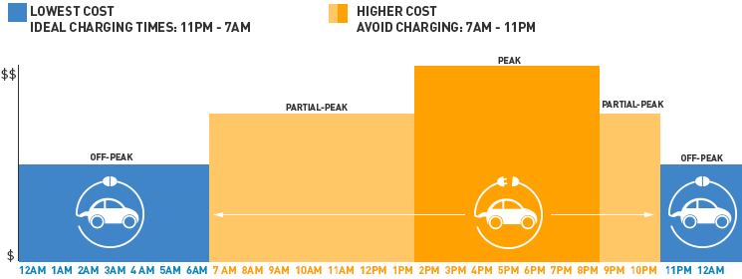
Which PG&E rate schedule is best for solar?
Understanding peak hours
https://news.energysage.com/pge-rate-schedule-increase-solar/
If you have an electric vehicle, there are also special TOU rates that offer a lower rate overnight. These TOU rates will significantly reduce the cost of charging your electric car so long as it’s during nighttime hours.

Slide 39
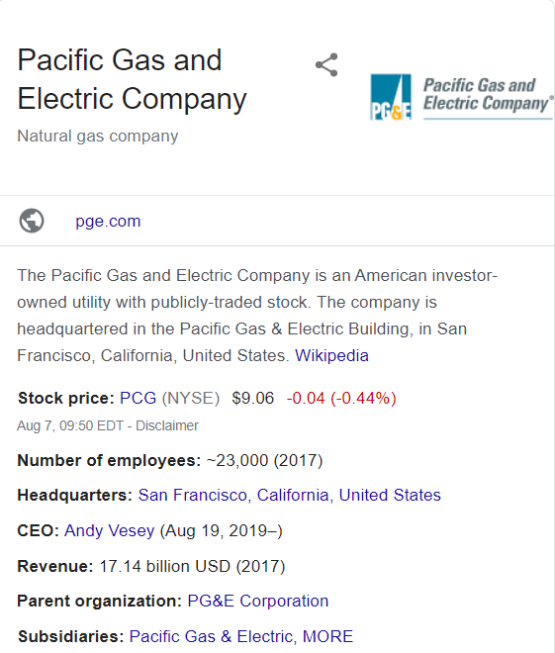
2001 bankruptcy[edit]
Main article: California electricity crisis
In 1998, a change in the regulation of California's public utilities, including PG&E, began. The California Public Utility Commission (CPUC) set the rates that PG&E could charge customers and required them to provide as much power as the customers wanted at rates set by the CPUC.
In the summer of 2001 a drought in the northwest states and in California reduced the amount of hydroelectric power available. Usually PG&E could buy "cheap" hydroelectric power under long term contracts with the Bonneville Dam and other sources. Drought and delays in approval of new power plants and market manipulation decreased available electric power generation capacity that could be generated in state or bought under long term contracts out of state. Hot weather brought on higher usage, rolling blackouts, and other problems.
With little excess generating capacity of its own PG&E was forced to buy electricity out of state from suppliers without long term contracts. Because PG&E had to buy additional electricity to meet demand, some suppliers took advantage of this requirement and manipulated the market by creating artificial shortages and charged very high electrical rates, as exemplified by the Enron scandal. The CPUC refused to adjust the allowable electric rates. Unable to change rates and sell electricity to consumers for what it cost them on the open market PG&E started hemorrhaging cash.
PG&E Company (the utility, not the holding company) entered bankruptcy under Chapter 11 on April 6, 2001. The state of California tried to bail out the utility and provide power to PG&E's 5.1 million customers under the same rules that required the state to buy electricity at market rate high cost to meet demand and sell it at lower fixed price, and as a result, the state also lost significant amounts of money. The crisis cost PG&E and the state somewhere between $40 and $45 billion.^{[64]}
PG&E Company, the utility, emerged from bankruptcy in April 2004, after paying $10.2 billion to its hundreds of creditors. As part of the reorganization, PG&E's 5.1 million electricity customers will have to pay above-market prices for several years to cancel the debt.

Slide 40

2019 bankruptcy[edit]
Chronology[edit]
Facing potential liabilities of $30 billion from the wildfire, the electrical utility that was responsible for the transmission line suspected of sparking the wildfire, Pacific Gas and Electric (PG&E), on January 14, 2019, began the process of filing for bankruptcy with a 15-day notice of intention to file for bankruptcy protection.^{[65][66][67]} On January 29, 2019 PG&E Corporation, the parent corporation of PG&E, filed for bankruptcy protection.^{[68][69]} Because fire survivors are unsecured creditors with the same priority as bondholders, they will only be paid in proportion to their claim size if anything is left after secured and priority claims are paid; it nearly ensures that they will not get paid in full.^{[70]} PG&E had a deadline of June 30, 2020 to exit bankruptcy in order to participate in the California state wildfire insurance fund established by AB 1054 that helps utilities pay for future wildfire claims.^{[71][72][73][74]}
As part of its emergence from bankruptcy, it will pay wildfire victims $13.5 billion; half of that amount will be paid in company stock, resulting in 70,000 fire victims owning 22% of the company.^{[144]}

Slide 41
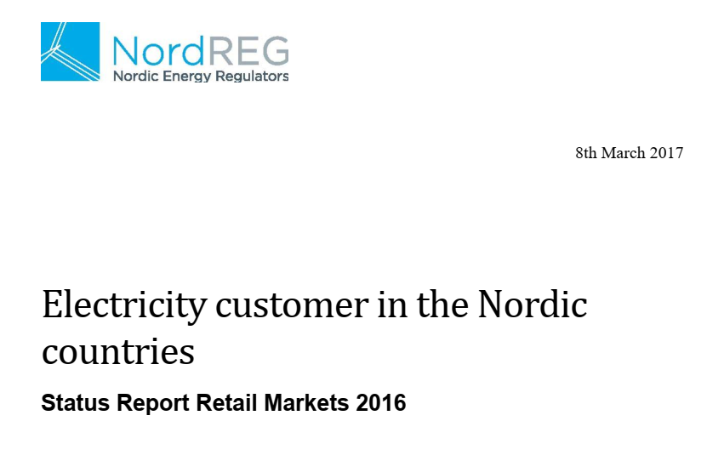
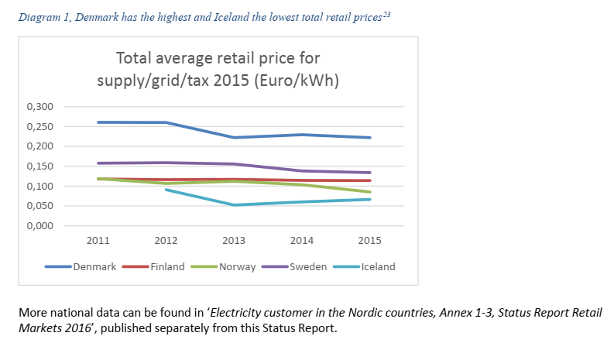

Slide 42


Slide 43
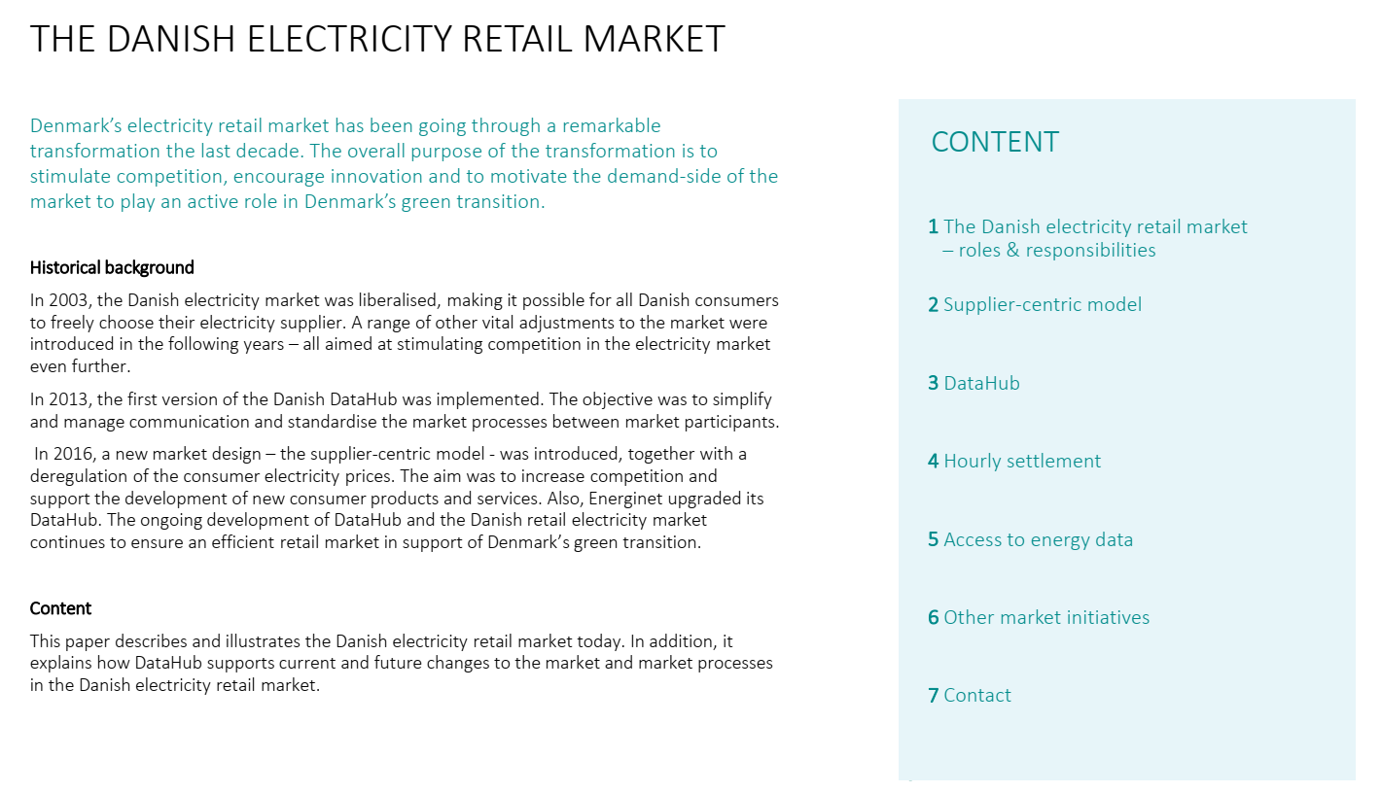
In 2016, a new market design – the supplier-centric model - was introduced, together with a deregulation of the consumer electricity prices. The aim was to increase competition and support the development of new consumer products and services. Also, Energinet upgraded its DataHub. The ongoing development of DataHub and the Danish retail electricity market continues to ensure an efficient retail market in support of Denmark’s green transition.

Slide 44
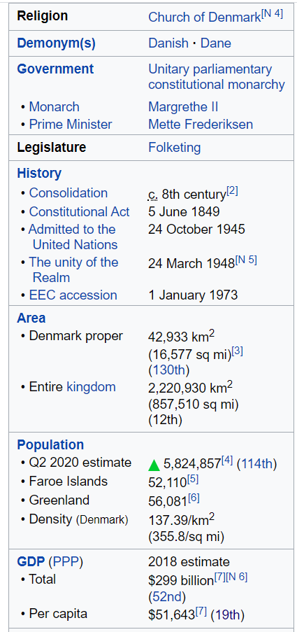
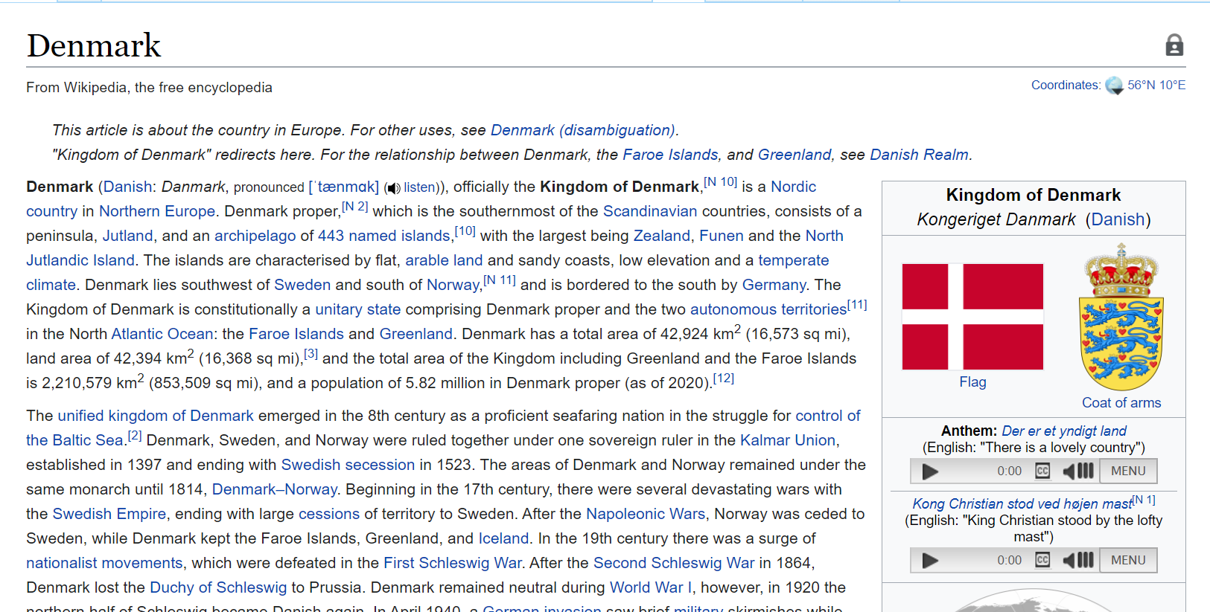

Slide 45
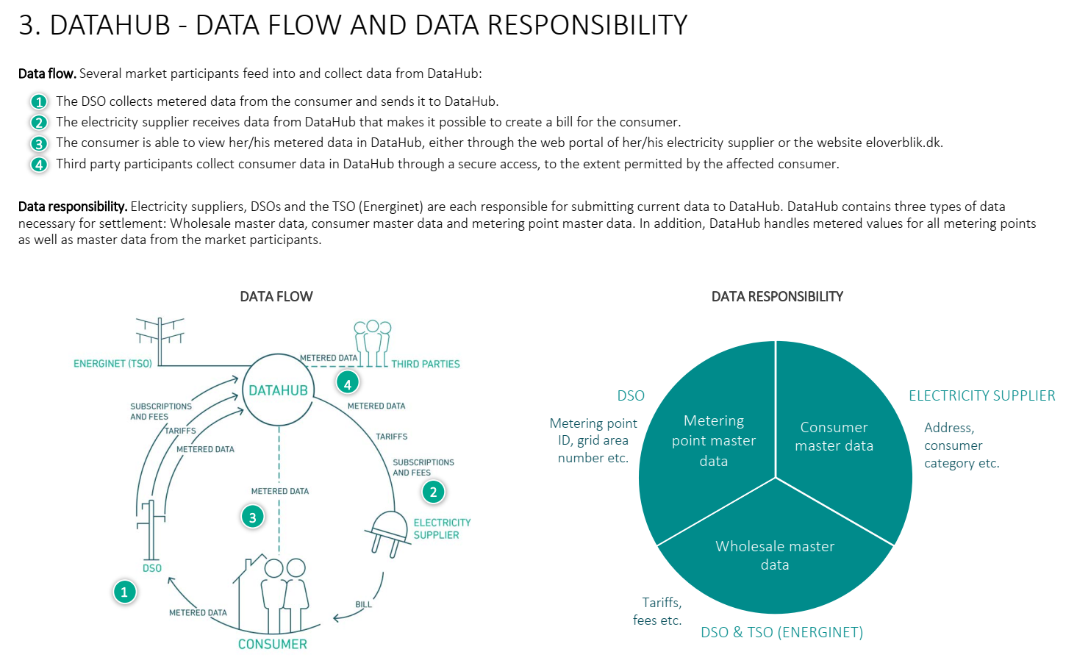

Slide 46
