Slide 1
MÓDULO 2
Fundamentos Técnicos dos BESS
Setembro, 2026

Slide 2
Sistemas de Controle e Potência: BMS (Battery Management System); PCS (Power Conversion System); EMS (Energy Management System); Round-Trip Efficiency.
Estrutura Física e Funcional do BESS: Célula, Módulo; Rack; Tensão; Potência; Energia; C-rate.
15 mins
10 mins
10 mins
25 mins
SoC e SoH: SoC e SoH não são medidos diretamente, são estimados; SoH mede o envelhecimento ou perda de desempenho interno (resistência interna subindo); Curva de Degradação x Ciclos; Refrigeração e Segurança.
Dimensionamento Básico: Aplicações: arbitragem (2h a 4h); Serviços ancilares (10 min a 1h); reserva de capacidade (4h 2x ao dia); Discussão sobre Augmentation.

Slide 3
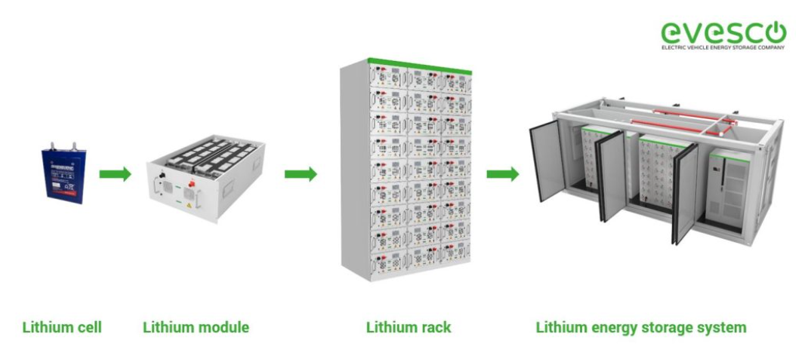
Estrutura Física e Funcional do BESS
Container
https://www.power-sonic.com/battery-energy-storage-system-components/

Slide 4
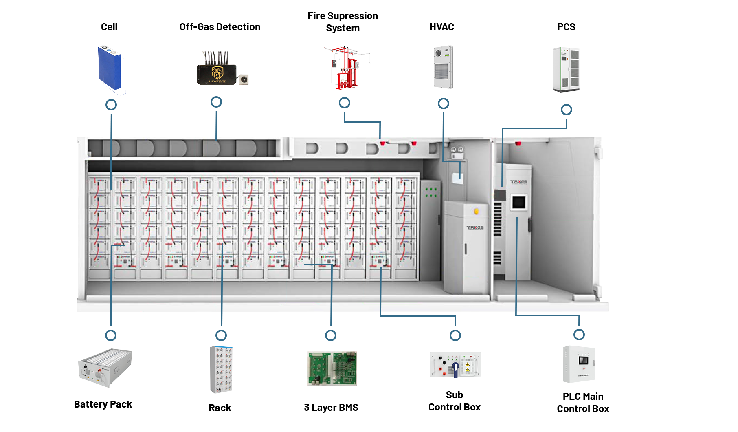
Estrutura Física e Funcional do BESS
3 Layer BMS
https://troescorp.com/what-is-battery-energy-storage/

Slide 5
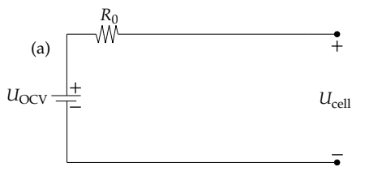
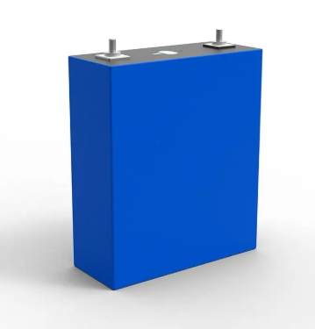
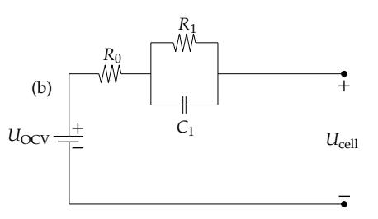
Estrutura Física e Funcional do BESS
The Rint Model (Internal Resistance Model)
3.2V 320Ah Prismatic High Capacity LFP Battery Cell - LiFePO4 Battery
The Thevenin Model (First-Order RC)
Nominal Voltage = 3.2V
Nominal Capacity = 320Ah
Charge Current
Discharge Current
Cycle Life (Cycle Number)
Auch, M.; Kuthada, T.; Giese, S.; Wagner, A. Influence of Lithium-Ion-Battery Equivalent Circuit Model Parameter Dependencies and Architectures on the Predicted Heat Generation in Real-Life Drive Cycles. Batteries 2023, 9, 274. https://doi.org/10.3390/batteries9050274

Slide 6
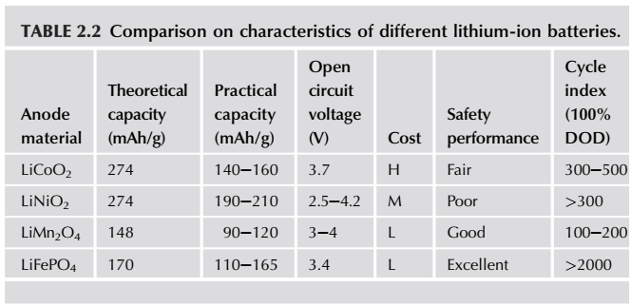
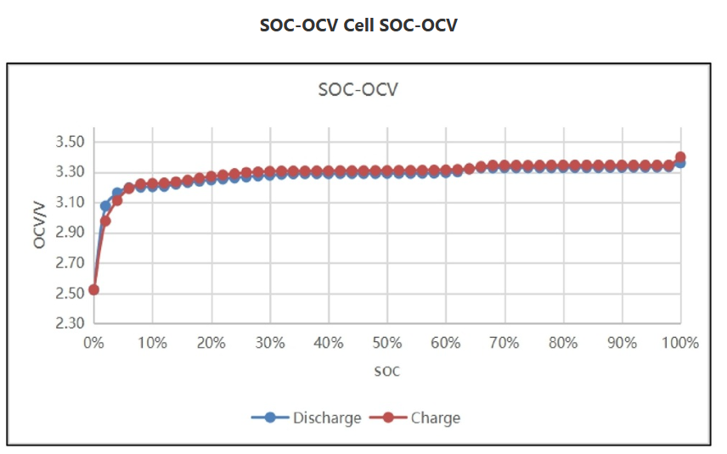
Estrutura Física e Funcional do BESS
Fu-Bao Wu, Bo Yang and Ji-Lei Ye (Editors), “Grid-Scale Energy Storage Systems and Application”, Academic Press (an imprint of Elsevier), 2019.
https://www.evlithium.com/LiFePO4-Battery/byd-blade-battery-138ah.html
One tricky thing about LFP is that the discharge curve is extremely flat. A cell at 3.3V could be at 90% charge or 20% charge. This is why LFP batteries require a BMS (Battery Management System) that uses "Coulomb Counting" (measuring current in/out) rather than just voltage to tell you the remaining capacity.

Slide 7
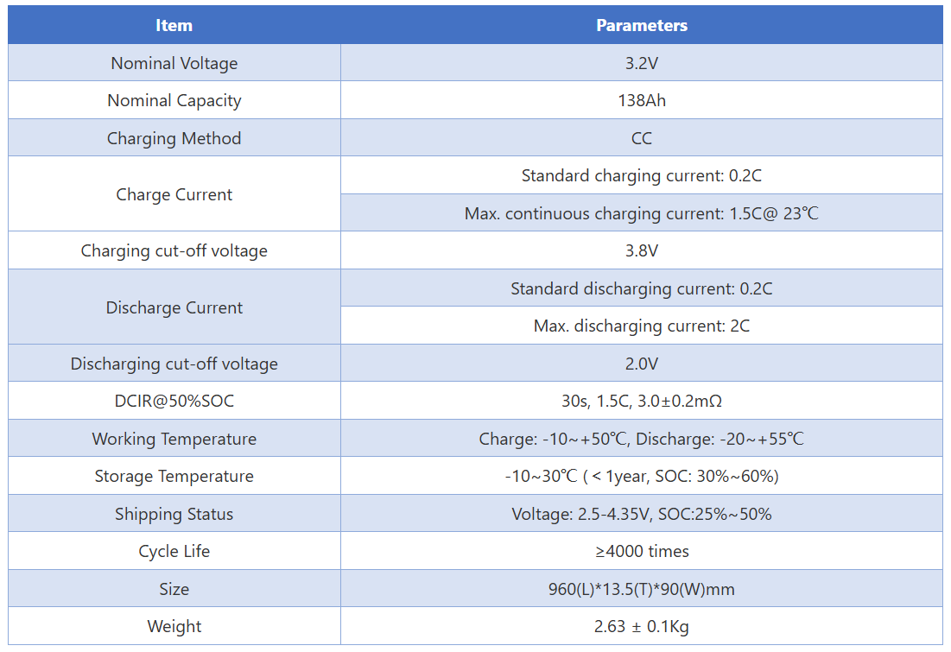
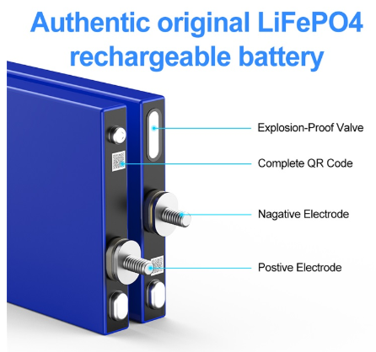
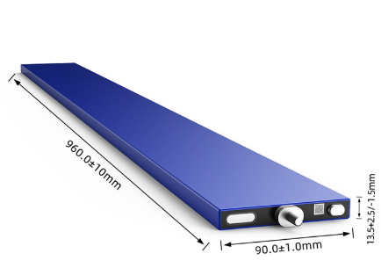
Estrutura Física e Funcional do BESS
BYD LiFePO4 Blade Battery 3.2V 138Ah
https://www.evlithium.com/LiFePO4-Battery/byd-blade-battery-138ah.html

Slide 8
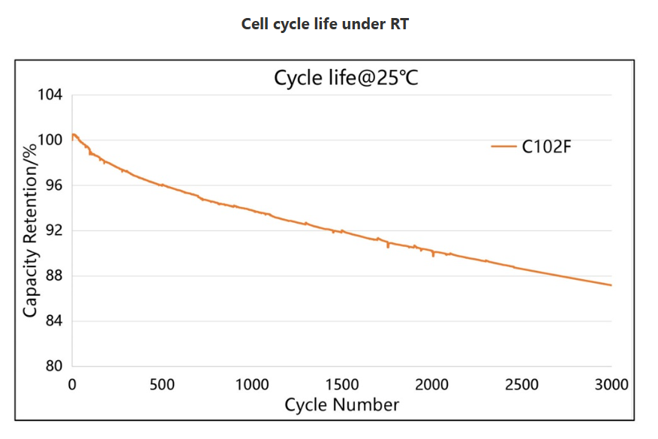
Estrutura Física e Funcional do BESS
(Room Temperature)
Importantíssimo monitorar a tensão e a corrente da célula!
Most battery manufacturers define the "end of life" for a cell when its capacity retention drops to 80%. Because at this graph it still at ~87% after 3,000 cycles, this specific LFP cell is very high-quality. If the trend continues linearly, this cell would likely reach its 80% "end of life" mark at around 4,500 to 5,000 cycles.
https://www.evlithium.com/LiFePO4-Battery/byd-blade-battery-138ah.html

Slide 9
Estrutura Física e Funcional do BESS
Vamos imaginar que queremos dimensionar uma BESS para nossa casa para suportar uma demanda de 5000 W por 2 horas.Quantas células “BYD LiFePO4 Blade Battery 3.2V 138Ah” vamos precisar???
For 100 Ah capacity, I could discharge it at 300 A???
Only if the battery is designed to allow such a high C-rate.
That depends on the battery chemistry and manufacturer specifications:
Lithium-ion cells often allow 1C to 3C continuous, but some high-power cells allow 5C+, even 10C bursts.
Lead-acid batteries usually allow only ~0.2C to 0.5C continuous; 3C would damage them.
LiFePO₄ (LFP) cells often allow 1C–2C continuous, maybe 3C for short pulses depending on model.

Slide 10
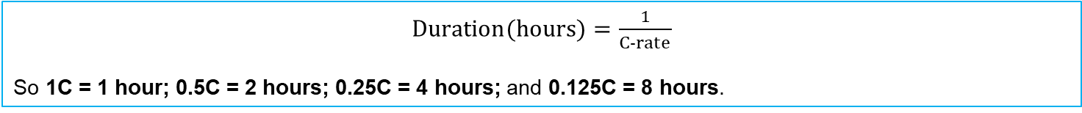
C-Rate
The C-rate is a normalized parameter used to characterize the charging or discharging rate of a battery relative to its nominal energy capacity.
It is commonly defined as the ratio between the battery power and energy ratings, expressed in MW/MWh. For instance, a BESS rated at 20 MW/80 MWh operates at a maximum C-rate of 0.25C, corresponding to a nominal discharge duration of approximately four hours at rated power.
In general, the C-rate provides a convenient indication of the operational intensity of the battery, since higher C-rates imply faster charge and discharge processes and may result in increased thermal and electrochemical stress, with potential impacts on efficiency, degradation, and battery lifetime.
$Duration(hours)=\frac{1}{C-rate}$​
So 1C = 1 hour; 0.5C = 2 hours; 0.25C = 4 hours; and 0.125C = 8 hours.

Slide 11
C-Rate
Commercial lithium-ion cells now exist that can accept charging rates around 4C, which corresponds theoretically to a full charge in about 15 minutes. For example, CATL’s Shenxing LFP technology is marketed as a 4C superfast-charging battery. EVE Energy also lists commercial cells with continuous charge capability up to 3C and fast-charge products in the roughly 10–20 minute range.
However, there is an important distinction: for example, “4C” does not always mean charging from 0% to 100% in exactly 15 minutes under all conditions. Manufacturers often specify fast charging over a limited SOC window, such as 10–80% or 20–80%, because charging must usually slow down near high SOC to control lithium plating, temperature, and degradation. So, in practical terms, a cell described as “15-minute fast charging” usually means something like 10–80% SOC in approximately 10–15 minutes, not necessarily a complete 0–100% charge.
High C-rate charging imposes significant electrochemical and thermal stress on lithium-ion batteries. At elevated charging currents, lithium ions must be rapidly transported and intercalated into the anode material, increasing the risk of lithium plating when the intercalation rate becomes insufficient. In addition, higher currents result in increased heat generation and can accelerate side reactions, including solid-electrolyte interphase growth and electrolyte degradation. These mechanisms (lithium plating and heat generation) may lead to faster capacity fade and reduced battery lifetime. Consequently, very high charging rates, such as 4C, are generally applied only within specific temperature and state-of-charge ranges () and require appropriate cell design and thermal management.

Slide 12
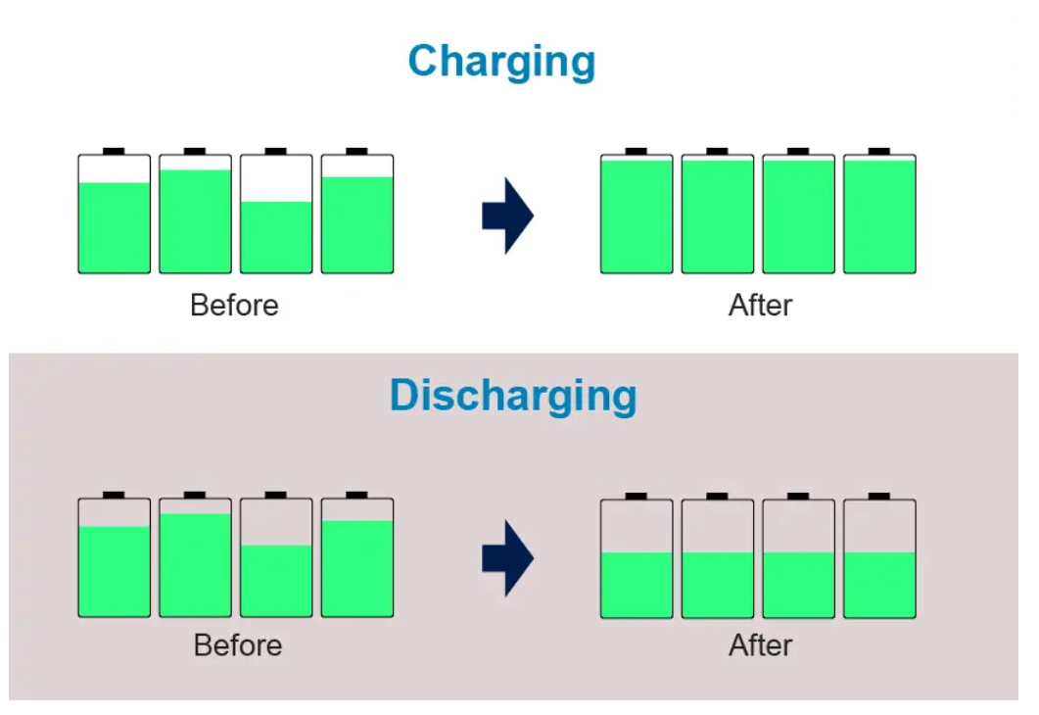
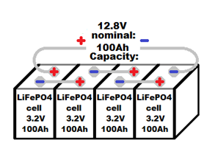
Estrutura Física e Funcional do BESS
Config. | Voltage (V) | Capacity (Ah) | Energy (Wh)
4S1P | 12.8V | 100Ah | 1,280Wh
8S1P | 25.6V | 100Ah | 2,560Wh
16S1P | 51.2V | 100Ah | 5,120Wh
16S2P | 51.2V | 200Ah | 10,240Wh
The downside of a series connection is that the battery module is only as strong as its weakest cell. If one cell in a series string dies or drops to 2.0V, the entire string must stop providing power to protect that one cell. This is why battery modules absolutely require a BMS (Battery Management System) to perform "balancing," ensuring every cell in the series stays at the same voltage level
https://www.evlithium.com/Blog/how-to-top-balance-lifepo4-cells.html

Slide 13
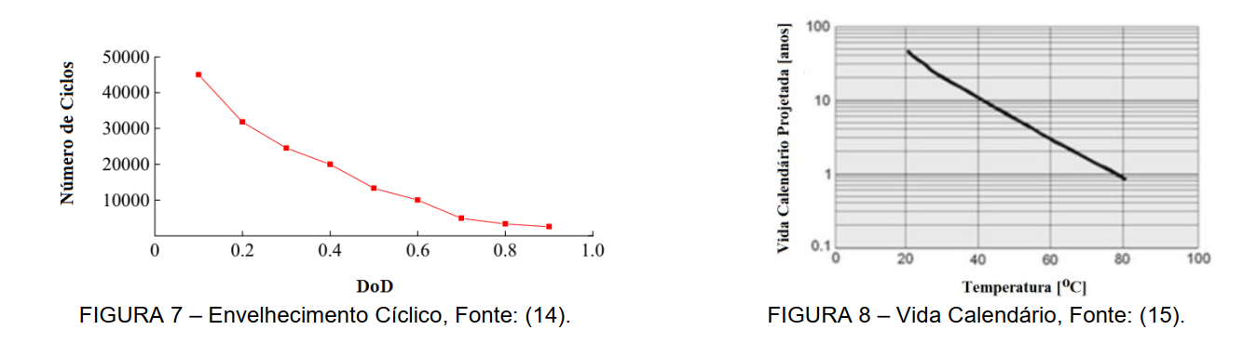
SoC (State of Charge) e SoH (State of Health)
Alex Coutinho, Eduardo Sodré, Rodrigo Salim, Marina Dantas e Alcides Codeceira Neto, "Análise de Portfólio de Geração Eólica e Solar com Armazenamento em Mercados de Energia Horário", XXV SNPTEE - Seminário Nacional de Produção e Transmissão de Energia Elétrica, 10 a 13 de novembro de 2019 – Belo Horizonte - MG.

Slide 14
SoC (State of Charge) e SoH (State of Health)
SoC: quantidade de energia disponível (%).
SoC = Energia_disponível / Energia_nominal
Importância operacional:
• Limites de SoC reduzem degradação e risco térmico.
• Faixa típica de operação: 10–90% ou 20–80%.
Estimativa prática de SoC:
• Integração de corrente (coulomb counting)
• Tensão terminal
• Modelos internos e filtros (ex.: Kalman)
Observação: SoC não é medido diretamente, é estimado.
SoH: indicador de degradação do sistema.
Formas típicas de avaliação:
• SoH = Capacidade atual / Capacidade nominal
• Ou baseado em aumento de resistência interna
Interpretação:
• SoH = 100% (novo)
• SoH = 80% (perda de 20% de capacidade)
Contratos de fornecimento geralmente garantem capacidade mínima após certo tempo/ciclos.
Despite their robustness, LFP batteries can suffer from SoC drift over time. Errors in coulomb counting – including initial-value errors, noise errors, and current measurement errors – can accumulate over time. Regular calibration of SoC measurements using periodic full charge and discharge cycles is necessary to correct such errors and restore accuracy. [https://www.ess-news.com/2024/09/25/the-significance-of-state-of-charge/#:~:text=SoC%20is%20typically%20expressed%20as,markets%2C%20resulting%20in%20imbalance%20costs ]

Slide 15
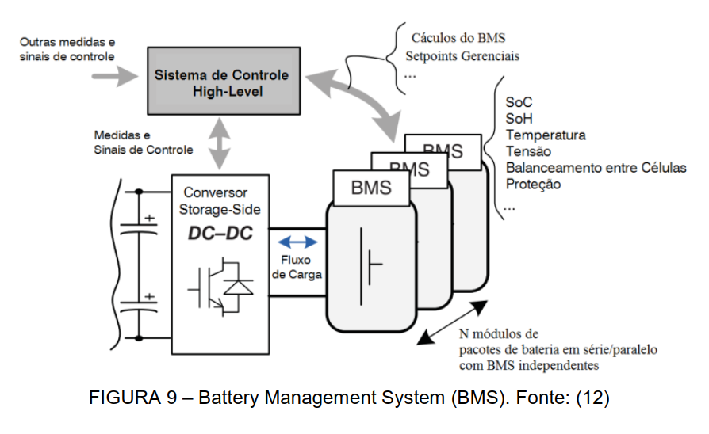
Sistemas de Controle e Potência: BMS, PCS e EMS
e Round-Trip Efficiency
Alex Coutinho, Eduardo Sodré, Rodrigo Salim, Marina Dantas e Alcides Codeceira Neto, "Análise de Portfólio de Geração Eólica e Solar com Armazenamento em Mercados de Energia Horário", XXV SNPTEE - Seminário Nacional de Produção e Transmissão de Energia Elétrica, 10 a 13 de novembro de 2019 – Belo Horizonte - MG.

Slide 16
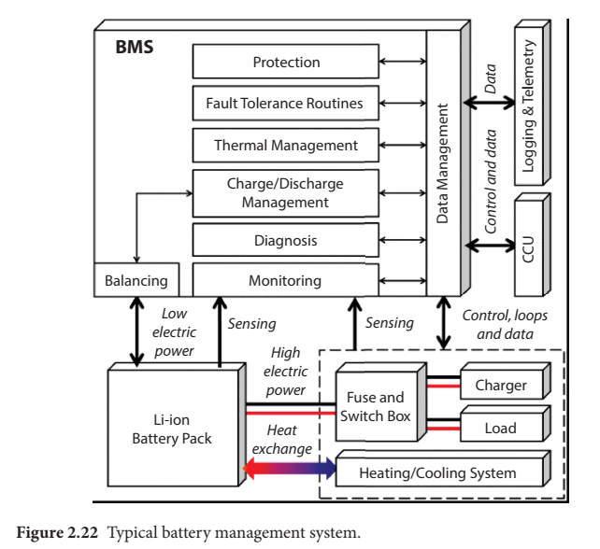
Sistemas de Controle e Potência: BMS, PCS e EMS
e Round-Trip Efficiency
S. Dhundhara, Y. Pal Verma and A. Kumar (Editors), “Energy Storage Technologies in Grid Modernization”, Scrivener Publishing / Wiley, First published:13 July 2023, DOI:10.1002/9781119872146

Slide 17
Sistemas de Controle e Potência: BMS, PCS e EMS
e Round-Trip Efficiency
The BMS must have the real-time monitoring and uploading of relevant parameters of energy storage batteries, monitor the overall status of the batteries, and automatically repair in time.
The main functions of the BMS should include the following aspects:
Battery parameter test and management;
Data communication management;
Online SoC diagnosis;
SoH diagnosis;
Balance management; and
Failure diagnosis and protection.
In a BMS the main limits to be set up include:
charge/discharge overcurrent values;
monomer (one single cell) overvoltage/undervoltage values;
high/low temperature limit;
SOC high/low values; and
battery module overvoltage/undervoltage values.
Geralmente o protocolo de comunicação do BMS com o PCS são proprietários.
Fu-Bao Wu, Bo Yang and Ji-Lei Ye (Editors), “Grid-Scale Energy Storage Systems and Application”, Academic Press (an imprint of Elsevier), 2019.

Slide 18
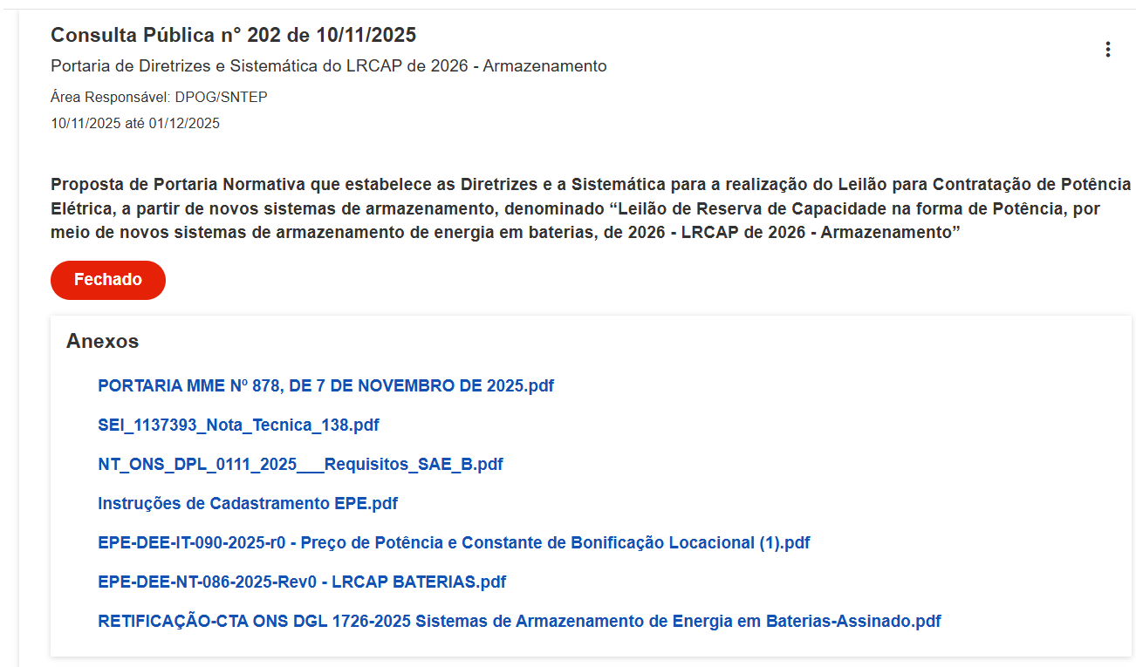
Dimensionamento Básico
https://www.gov.br/mme/pt-br/acesso-a-informacao/participacao-social/audiencia/audiencias-e-consultas-publicas

Slide 19
Dimensionamento Básico
REQUISITOS DA CONSULTA PÚBLICA DO LRCAP-ARMAZENAMENTO 2026
(https://www.gov.br/mme/pt-br/acesso-a-informacao/participacao-social/audiencia/audiencias-e-consultas-publicas)
≥30 MW e 4h (exatamente o mínimo permitido).
Recarga ≤6h
RTE ≥85% no PMI
PCS grid-forming + requisitos ONS (modelos PSCAD/ANATEM, PMU, supervisão/controle, QEE, etc.).
Montante de uso de rede: prever importação para recarga e exportação para descarga total.
Qual a estratégia? “instalar 150 MWh e fazer augmentation” ou “superdimensionar e não fazer augmentation”?

Slide 20
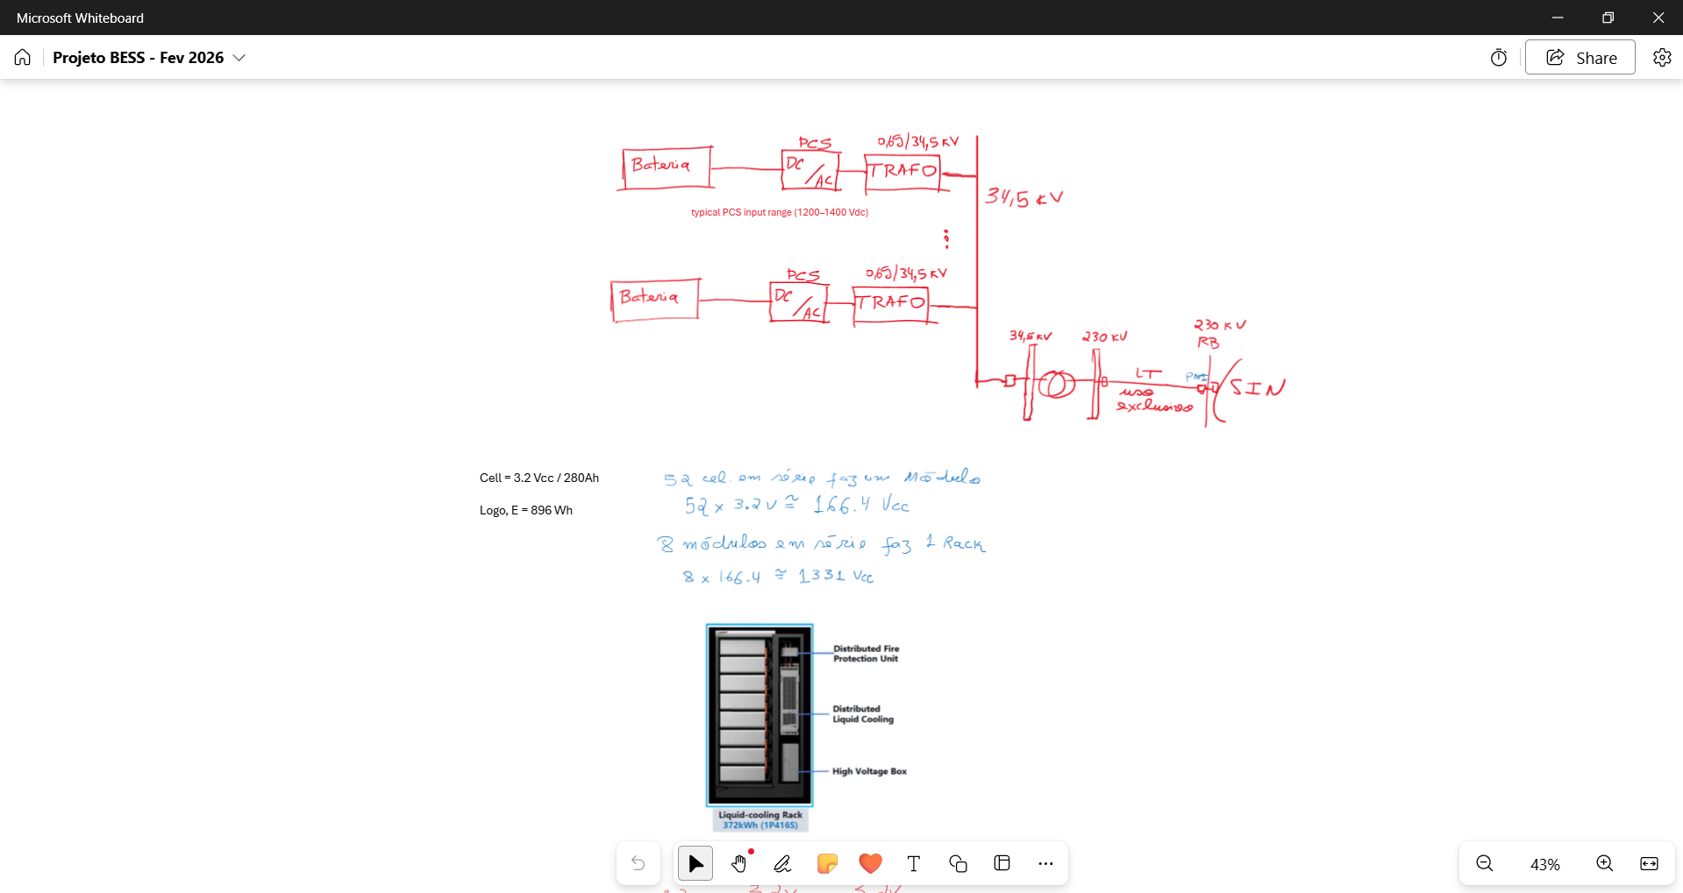
Dimensionamento Básico

Slide 21
Síntese Final
• BESS é um sistema integrado: bateria + BMS + PCS + EMS + refrigeração + segurança.
• C-rate define intensidade de operação.
• DoD é importantíssimo para manutenção da vida útil.
• SoH indica a energia efetivamente disponível.
• Dimensionamento deve considerar restrições operacionais (grid codes) e envelhecimento (Augmentation).

