Slide 1


Slide 2
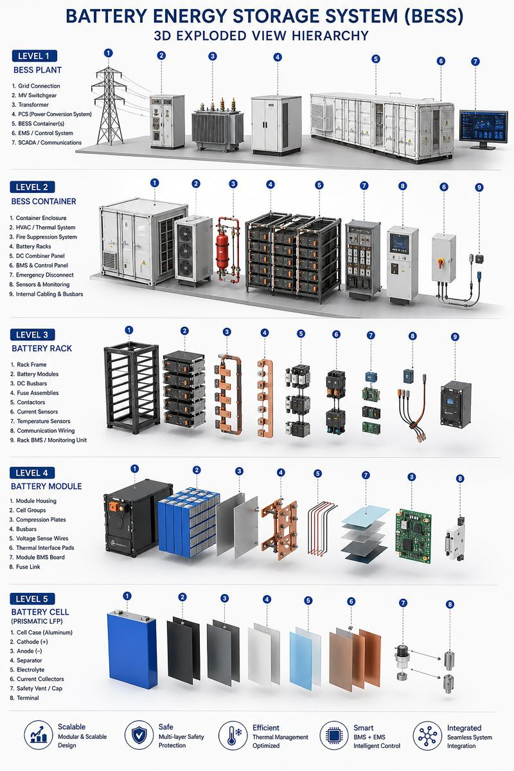
Battery Energy Storage Systems (BESS): More Than Just "Big Batteries" The exploded-view hierarchy below highlights something often overlooked in discussions about grid-scale energy storage: A modern BESS is not simply a collection of battery cells—it is a highly integrated electromechanical, thermal, power-electronics, and software platform. At the plant level, the Power Conversion System (PCS) serves as the heart of the installation, converting power between the grid and battery system.
Modern utility-scale deployments increasingly utilize 1500V DC architectures, medium-voltage PCS designs, and grid-forming inverter capabilities to improve efficiency, support black-start operation, and enhance grid stability. Inside the container, energy density continues to climb. While 2–6 MWh containers have become common, the industry is rapidly moving toward liquid-cooled 5–7+ MWh platforms.
Advanced thermal management enables tighter battery packing, improved temperature uniformity, and higher continuous power capability. At the rack and module level, manufacturers are simplifying architectures through cell-to-pack designs, advanced compression systems, and integrated thermal propagation barriers that improve both safety and cost efficiency. At the cell level, LFP remains the dominant chemistry for stationary storage due to: - Long cycle life (6,000–8,000+ cycles) - Superior thermal stability - Reduced cobalt and nickel dependence - Lower total cost of ownership.
Emerging technologies such as LMFP and sodium-ion batteries are also beginning to appear in pilot deployments, particularly where cost and supply-chain resilience are priorities. Several industry trends are accelerating adoption: • Grid-forming inverters; • DC-coupled solar + storage architectures; • AI-driven energy management systems; • Long-duration storage (4–12+ hours); • Second-life and recycling integration; and • Factory-built plug-and-play deployments.
For AI data centers, BESS is evolving beyond backup power. Hyperscalers increasingly use energy storage for demand response, renewable firming, peak shaving, and behind-the-meter energy optimization. As global storage deployments continue growing at more than 40% annually in many markets, the industry's key differentiators are no longer just battery chemistry, they are system integration, software intelligence, thermal management, safety performance, and long-term bankability.
The future of energy storage belongs to the companies that can seamlessly integrate power electronics, batteries, thermal systems, controls, and software into a single scalable platform.
(Warning: Educational purpose only)

